Slide 1
Identifying Integers and their opposite
Do Now: Write <, > or =.
471 ___ 468 2. 108 ___ 95 3. 1,982 ___ 1,987

Slide 2
vocabulary
Positive Number: numbers that are greater than zero.
Negative Number: numbers that are less than zero.
Opposites: two numbers are opposite, if they are the same distance from zero on the number line but on different sides.
Integers: the set of all whole numbers and their opposites

Slide 3
Identifying numbers
Create a number line:
The number zero is neither positive nor negative.

Slide 4
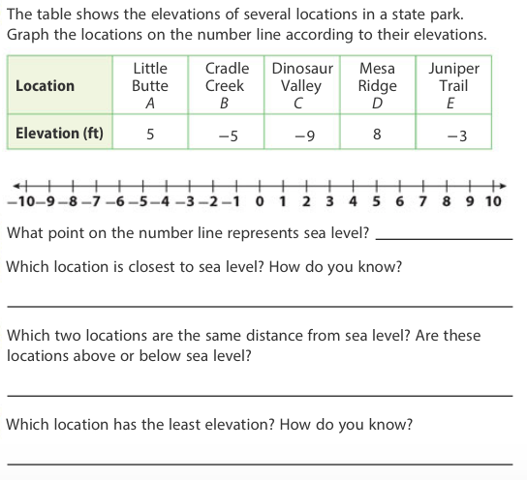

Slide 5
Try on your own
The Morning Glory Stream is 7 feet below sea level. What number represents the elevation of the Morning Glory Stream?
Explain how to graph the elevation of the Morning Glory Stream on a number line.

Slide 6
Opposites
When comparing opposites, create a number line first.
Using the number line, what is the opposite of 7?
Using the number line, what is the opposite of – 5?
Using the number line, what is the opposite of – 6?
Using the number line, what is the opposite of 4?

Slide 7
Try on your own
Using your number line, what is the opposite of 1?
Using your number line what is the opposite of – 3?
How does your number line show that 0 is its own opposite?
Explain how your number line shows that – 8 and 8 are opposites.

Slide 8
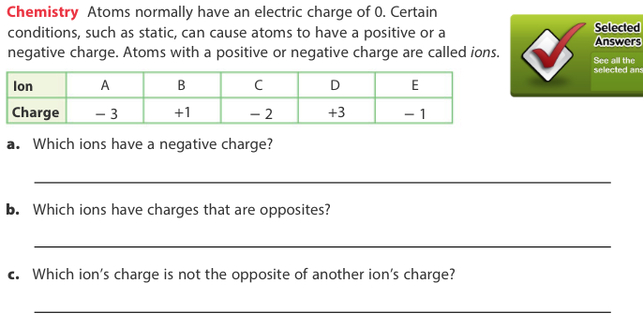
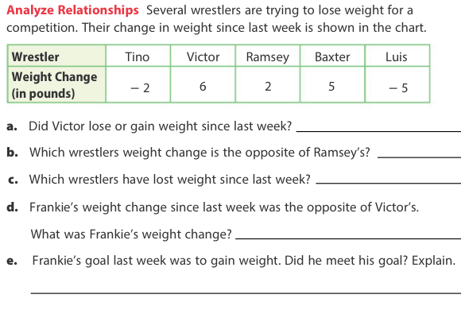
Classwork: Complete with your partner

