Slide 1

Where are the women in Math?
Exploring the underrepresentation of women in Math in our society..

Slide 2
Despite significant improvements over the last few generations, the discipline of mathematics still counts a disproportionately small number of women among its practitioners.
This underrepresentation is the result of implicit biases present within all of us, which cause us (on average) to perceive and treat women and men differently and unfairly. These mutually reinforcing biases begin in primary school, remain active through university study, and continue to oppose women's careers through their effects on hiring, evaluation, awarding of prizes, and inclusion in journal editorial boards and conference organization committees.

Slide 3
Video
Aspire to Inspire: Women in Mathematics
Article
Women in Academic Science: A Changing Landscape

Slide 4
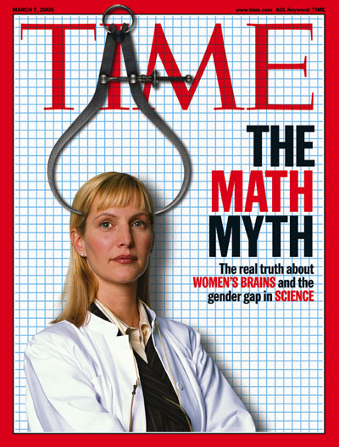
Important Organizations
AAUW http://www.aauw.org/
The American Association of University Women (AAUW) is the nation’s leading voice promoting equity and education for women and girls. Since our founding in 1881, AAUW members have examined and taken positions on the fundamental issues of the day — educational, social, economic, and political
JCW-Math https://jcwmath.wordpress.com/
Joint Committee on Women in the Mathematical Sciences
WIMSE http://wimse.fsu.edu/
WOMEN IN MATH, SCIENCE & ENGINEERING

