Slide 1
bullying in school
By: Mr. Brent Tupa
P.S. 128 M

Slide 2
PPA Process
Define the Problem
Gather the Evidence
Identify the Causes
Examine Existing Policy
Develop Policy Solution
Select the Best Solution

Slide 3
define the problem: bullying in school
Bullying in school hurts kids physically, emotionally, and psychologically.

Slide 4
Gather the Evidence
School Bullying Affects Us All
http://www.stopbullyingnowfoundation.org/main/
Bullying or Unkind Behavior? How to Know the Difference
http://bullying.about.com/od/Basics/a/Bullying-Or-Unkind-Behavior-How-To-Know-The-Difference.htm
Emotional, Physical, or Cyber: Bullying Hurts
http://www.psychalive.org/emotional-physical-or-cyber-bullying-hurts/
Facts and Statistics About Bullying
http://www.makebeatsnotbeatdowns.org/facts_new.html
Being Bullied Can Hurt Both Emotionally And Physically
http://www.bullyingtalk.com/being-bullied-can-hurt-both-emotionally-and-physically/

Slide 5
if bullying hurts so much, THEN why do people bully???

Slide 6
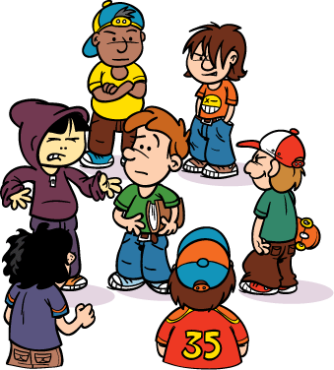
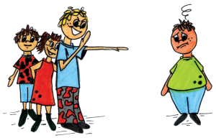
Identify the causes People bully because…
The feeling of power: Some people enjoy the feeling of power over other people.
Misunderstanding differences: Children don’t know how to handle differences between people. If a child does something different from other children, that child becomes a target.
Craving attention: Some children bully to get attention. Even though it is negative attention, it is better than feeling ignored.
A reflection on family and their own self-worth: Children who are emotionally abused and bullied by their own families end up bullying other kids. The bully may also have low self-esteem.
The media: Seeing something on a TV show or movie may make the child believe that bullying behavior is acceptable.

Slide 7
school bullying affects us all:
Did you know that every 7 minutes a child is bullied?
Bullying can have a big impact on both child and teenage students.
Students who are bullied often suffer from anxiety, fear, withdrawal, low self-esteem, and poor concentration.
A bullied student will often avoid school, have lower grades, and become socially isolated.
About 160,000 students miss school each day for fear of being bullied
There have been numerous reports of suicide due to bullying.

Slide 8
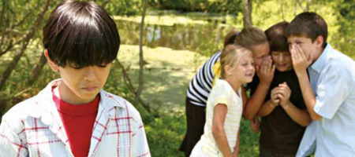

Slide 9
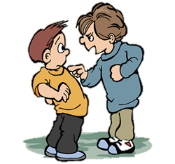
Bullies are also affected
Bullying is often a warning sign that children and teens are heading for trouble and are at risk for serious violence.
Teen (particularly boys) who bully are more likely to engage in other antisocial or delinquent behavior into adulthood.
They are 4 times more likely than nonbullies to be convicted of crimes.

Slide 10
Bullying or unkind behavior? how to know the difference:
Bullying:
Unkind Behavior:
Someone is purposely being excluded.
Joking and teasing becomes bullying when there is a conscious decision to hurt another person. This includes making mean comments, name-calling, spreading rumors, and making threats to someone.
When a child physically hurts others when things don’t go their way.
Speaking the truth without even thinking about consequences. Sometimes children have one-time comments about someone like “you’re hair is really messy.” While unkind, it comes from a place of innocence.
Being left out. It’s normal that a child won’t be invited to every event.
Teasing is not bullying as long as both kids find it funny. It’s done in a playful and friendly way.

Slide 11
Emotional, physical, or cyber: bullying hurts
Verbal, physical, and cyberbullying all have detrimental effects on the personality and esteem of the individual.
The victim of bullying may struggle with depression, anxiety, and loneliness. Sometimes these effects will continue into their adult life, leading to increased drug abuse and decreased social skills.
Cyberbullying especially increases the likelihood of depression and anxiety in teens.
Most victims of bullying tend to keep the abuse a secret because of shame and fear of even more pain from their bullies.

Slide 13
Facts & stats of bullying:
American schools harbor approximately 2.1 million bullies and 2.7 million of their victims
1 in 7 students in Grades K-12 is either a bully or a victim of bullying.
56% of students have personally witnessed some type of bullying at school
15% of all school absentees is directly related to fears of being bullied at school
90% of 4th through 8th graders report being victims of bullying
Bullying statistic say revenge is the strongest motivation for school shootings
87% of students said shootings are motivated by a desire to “get back at those who have hurt them.

Slide 14
Examining existing policy Anti-bullying programs:
Currently there are many laws and policies in each state that were created to prevent bullying and protect children.
In New York, there are anti-bullying laws that cover harassment, bullying, intimidations, taunting, discrimination, and cyberbullying.
Anti-bullying programs have been created and are available in many schools.
Schools that have an anti-bullying program, bullying is reduced by 50%.
Schools also suspend and sometimes expel a student who is guilty of bullying.

Slide 15
Develop Policy Solutions (How to stop bullying in schools):
Here are some things kids can do to address bullying:
Treat everyone with respect: Nobody should be mean to others! Stop & think before you say or do something that could hurt someone else.
Stand up for others: When you see bullying, there are safe things you can do to make it stop. Talk to a parent, teacher or another adult. Adults need to know when bad things happen so they can help! Be kind to the kid being bullied and show them that you care. Not saying anything could make things worse for everyone!
Protect yourself from cyberbullying: Always think about what you post online and keep your password a secret from other kids. Keep your parents in the loop and if you are being cyber bullied tell an adult you trust.

Slide 16
Let’s select the best solution
Treat everyone with respect including yourself: Nobody should be mean to others! Stop & think before you say or do something that could hurt someone else.

Slide 17
WHAT IF You're the VICTIM?
If you’re being bullied…
Look at the bully and tell him or her to stop in a calm, clear voice.
If speaking up seems too hard or not safe, walk away and stay away. Don’t fight back.
Most importantly, find an adult to stop the bullying on the spot!

Slide 18
get involved:
You can be a leader in preventing bullying in your school!
Find out about where and when bullying happens in your school. Think about what could help. Then, share your ideas!
Schools sometimes give students a voice in programs to stop bullying. Create posters for your school about bullying. Be a role model for the younger kids!

Slide 19
THE END

