Slide 1
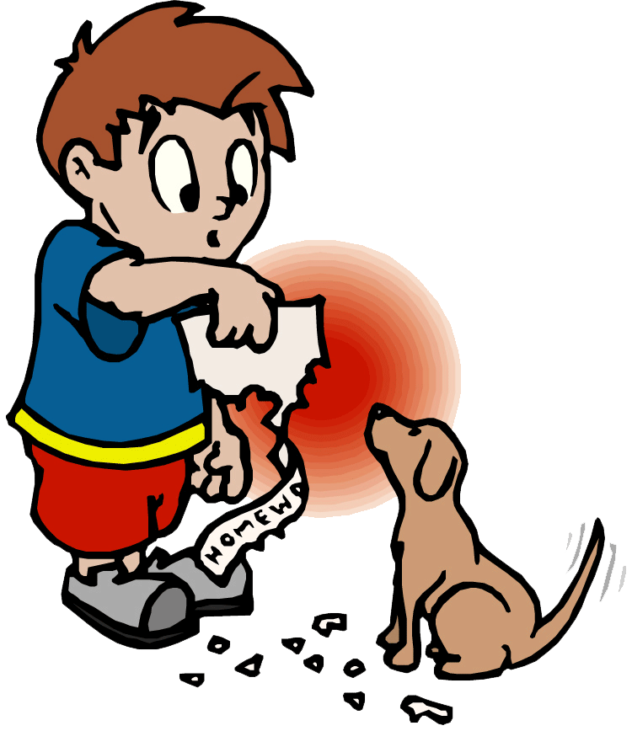
Students not completing Homework!
Stephanie Scala
P.S.28 Wright Brothers Elementary School
sscala2@schools.nyc.gov

Slide 2
PPA Process
  What is the problem?
  Where is the evidence?
  What are the causes?
  What is the existing policy?
  What policies can you create to correct the problem?
  What is the best policy to correct the problem?

Slide 3

What is Homework?
Homework is defined as out-of-class tasks assigned to students as an extension or elaboration of classroom work.

Slide 4

Why is Homework
Important?
Increases Learning
Teaches and Reinforces Good Work Habits
Teaches Responsibility
Teaches Time Management

Slide 5

Evidence
Research states that homework is not being done on a regular basis due to lack of interest in subject areas.
Research states that students are not completing homework due to excessive amounts being assigned.
Some teachers are more lenient then others in counting homework towards grades so students feel it is not important to complete.

Slide 6

Lets think…….
Why is homework not being completed by students?

Slide 7
Causes
Distraction from a nice day
No one to help with homework
No motivation to complete
Students not paying attention in class to understand how to complete the homework

Slide 8
Popular statements…
I didn’t have time
I lost it
I didn’t understand it

Slide 9
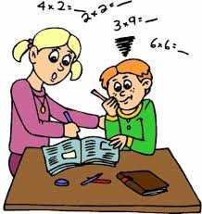
Existing Policies….
Homework completion plays a significant part in overall grades.
Students are required to complete homework each night.
Teachers more frequently are assigning and checking homework
Workshops/Tutors are becoming more popular in helping students with homework.

Slide 10

Solutions
Teachers can assign less work.
Teachers can assign work that is more fun and creative.
Develop a homework schedule, a spot and time where you can complete it everyday before participating in other activities.

Slide 11

Pick one!
Talk with your partner and decide on which solution YOU think is best to help with this problem!

Slide 12
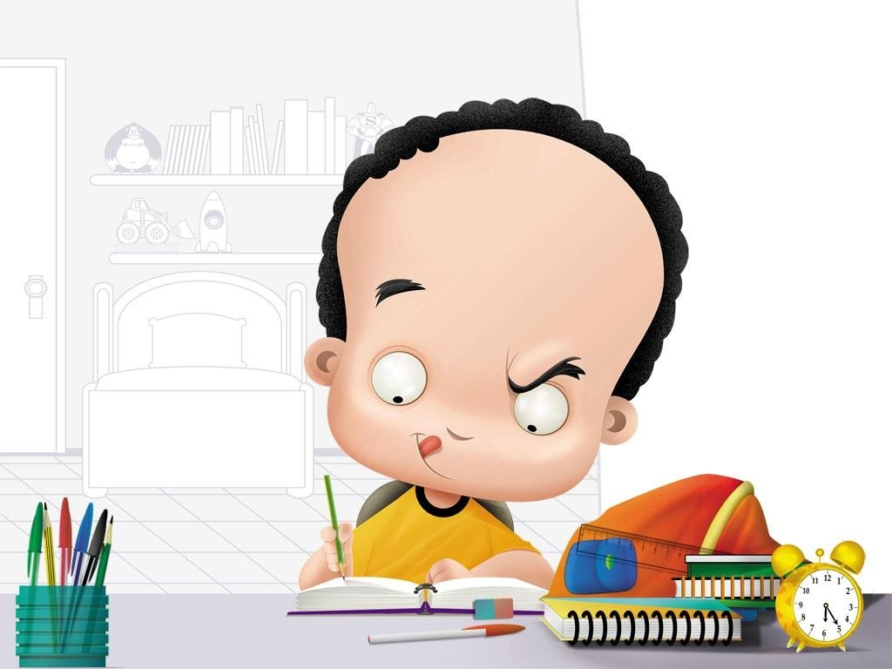
Now lets review and Vote!
What's your Opinion??

