Slide 1
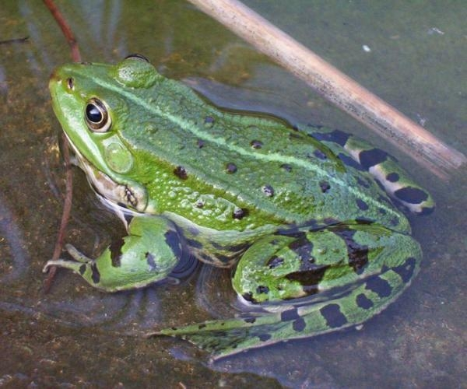
Endangered Animals: Fragile Frogs
Michelle Navarro
P.S. 128
The Aububon School

Slide 2
Public Analyst Process
Define the Problem
Gather the Evidence
Identify the Causes
Evaluate an Existing Policy
Develop Solutions
Select the Best Solutions (Feasibility vs. Effectiveness)
http://flippedtips.com/plegal/ppa/intro.html

Slide 3
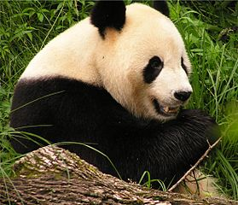
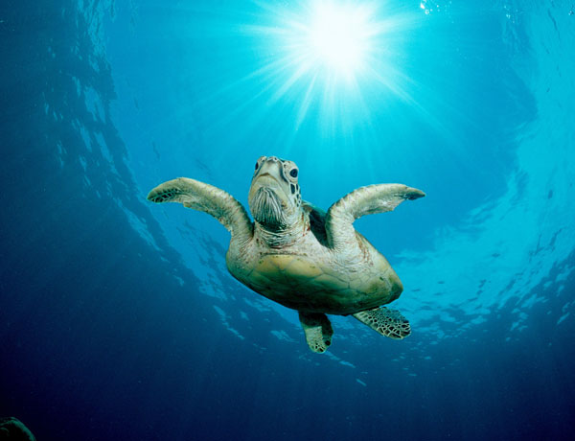
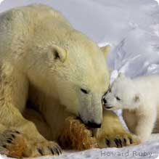
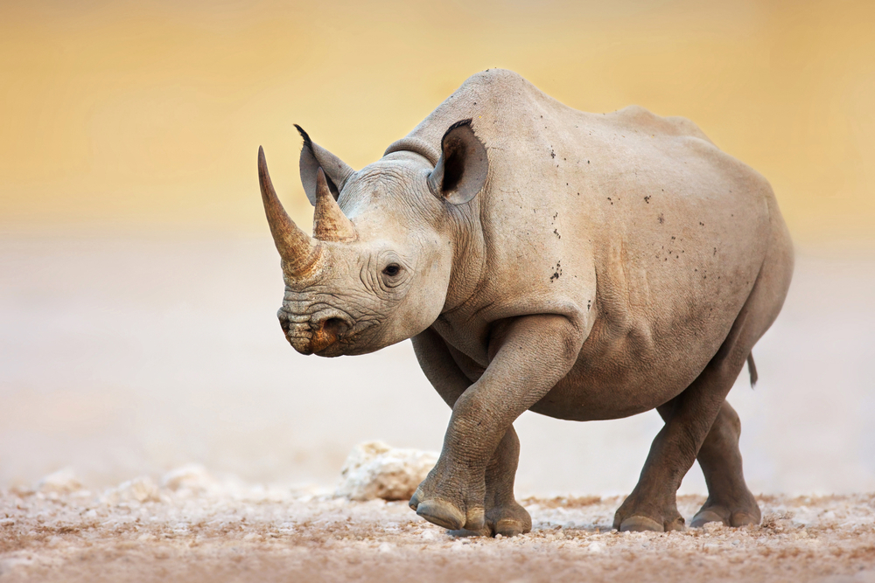
What is an endangered species?
An endangered species is a species of animal or plant that is seriously at risk of extinction or dying out completely.
World Wildlife Fund – List of Endangered Animals
Information about several endangered species

Slide 4
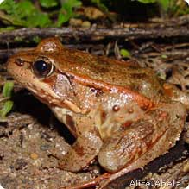
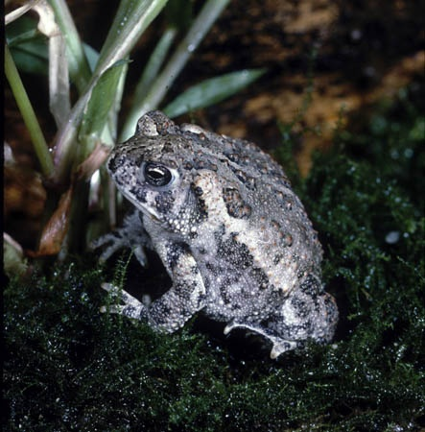
Define the Problem
Amphibians are the most endangered group of animals on the planet: nearly 1/3 of the world's amphibians are at risk of extinction.

Slide 5
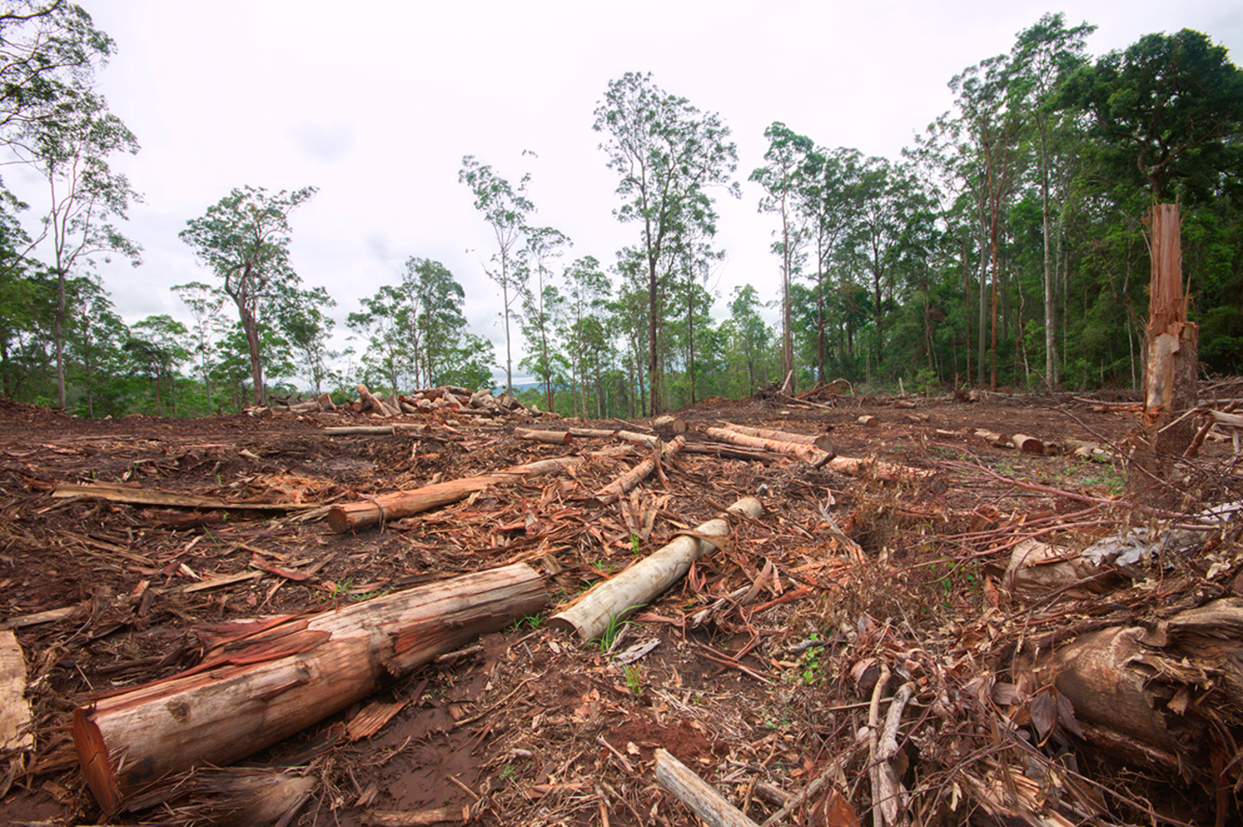
Causes of Frog Extinction
There are six major factors negatively affecting amphibians, and all are due to human activity:
1. Habitat destruction: humans are destroying habitats by cutting down trees, filling ponds, building highways etc.

Slide 6
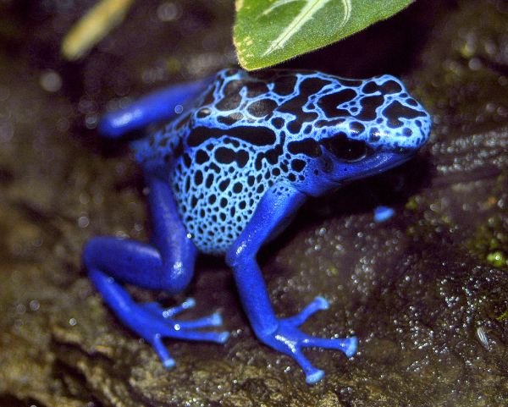
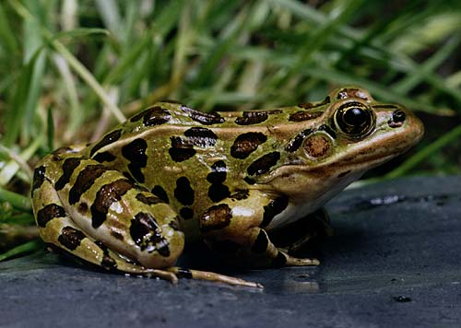
Causes of Frog Extinction
2. Infectious diseases: The chytrid (pronounced KIT-rid) fungus Batrachochytrium dendrobatidis (Bd) is the most significant threat to the world's mountain amphibian populations.
Blue Poison Dart Frog
Northern Leopard Frog
The deadly fungus was first discovered in both these species.

Slide 7
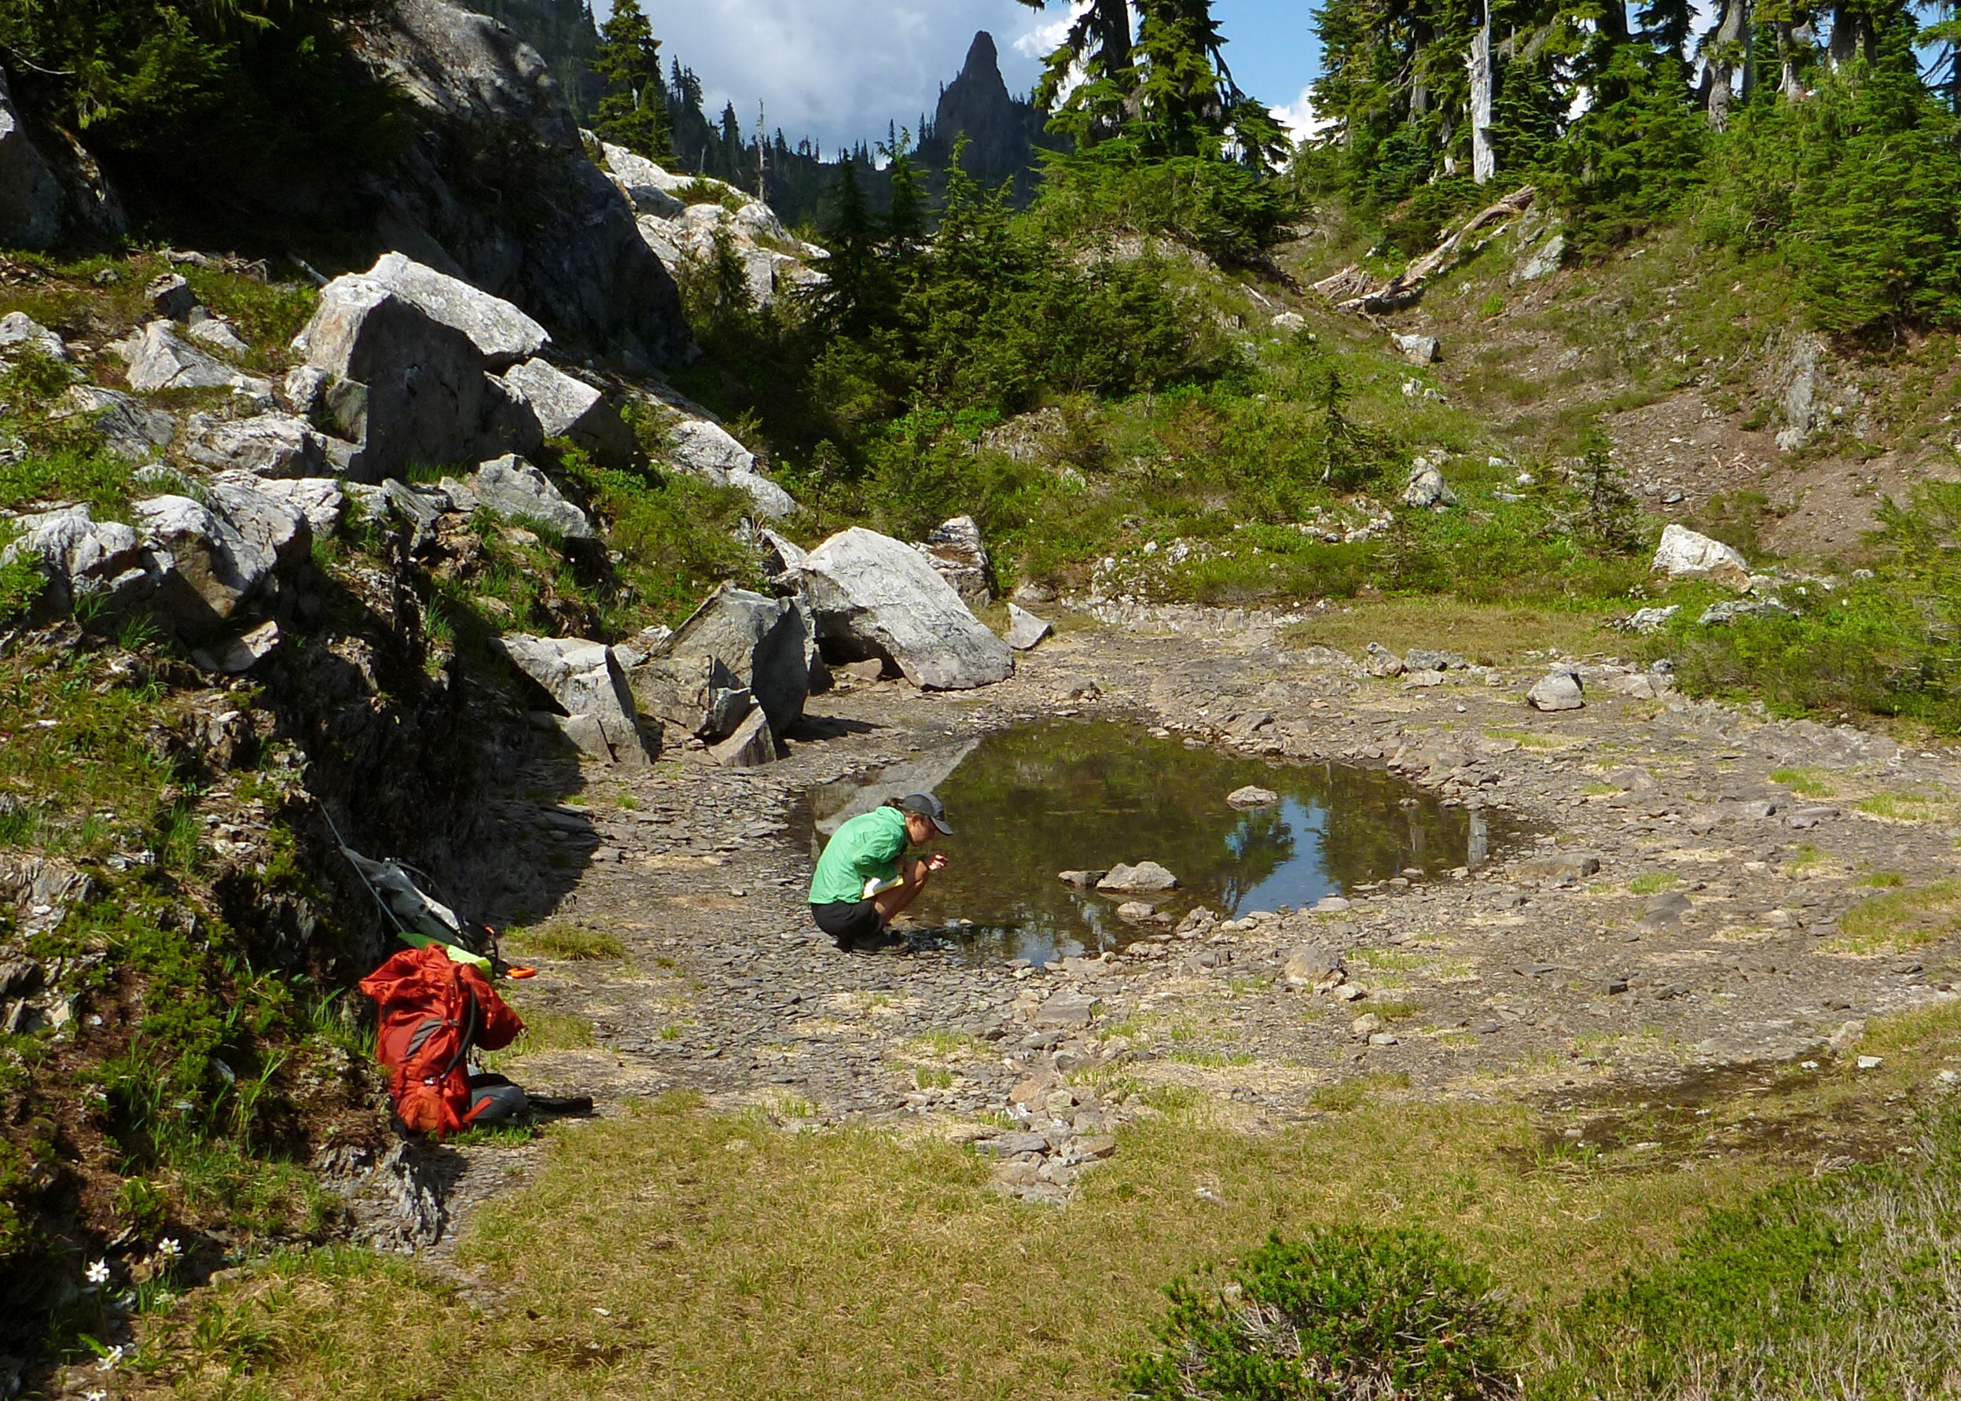
Causes of Frog Extinction
3. Climate change: Amphibians need moist climates to reproduce, and this makes them extremely sensitive to climate change. Frogs in high mountainous areas are most affected by global warming.
Climate change is ALREADY causing huge problems for the frogs!

Slide 8
Causes of Frog Extinction
4. Over-harvesting for the pet and food trades. The global market for frog legs and for pet frogs and salamanders is extensive. It is likely that over 100 million amphibians are removed from the wild each year.
5. Invasive species: Animals are set free on purpose or escape in their new environment. These species prey upon native species, compete with native species for resources and spread infectious diseases.

Slide 9
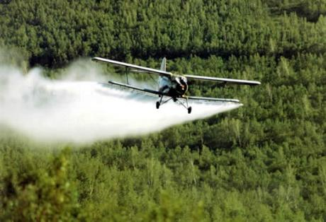
Causes of Frog Extinction
6. Pollution & pesticide: Pesticides (insecticides, fungicides, herbicides, etc...) are toxic chemicals. Many of these pesticides end up in waterways, where amphibians live and breed.

Slide 10
Evaluate an Existing Policy
Groups like SAVE THE FROGS the world’s leading amphibian conservation organization is raising awareness and fundraising to save amphibians.
Conservation centers like El Valle Amphibian Conservation Center (EVACC), supported by the Houston Zoo and the Panama Amphibian Rescue and Conservation Project at the Smithsonian are collecting frogs to protect them from extinction.
Scientist such James Cook University disease ecologist Jamie Voyles and her colleagues and scientists from James Madison University in Harrisonburg, Virginia Reid Harris and colleagues are working to find solutions to save frogs from the chytrid fungus.

Slide 11
Develop Solutions
Scientist and conservation organizations are working hard to save the frogs, but it is not enough.
Look at some of the causes of the decline in the amphibian population. Work with your group to develop new policies or solutions to help protect amphibians.
Look at SAVE THE FROGS to find out ways kids can help save the frogs: http://savethefrogs.com/gifts/info-cards/index.html

Slide 12
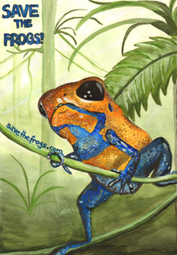
Select the Best Solution
Now that each group has developed 1 or 2 new policies or solutions, prepare to present your solution to the class.
We will now select the best solution by using these two criteria: feasibility and effectiveness. http://flippedtips.com/plegal/tips/bestsol.html

Slide 13
Additional Information
For more information about amphibians at risk go to the following websites:
http://savethefrogs.com/index.html
http://www.washingtonpost.com/world/scientists-try-to-save-the-frogs-as-time-runs-out/2012/12/30/3ac5ffec-48c3-11e2-8af9-9b50cb4605a7_story.html
http://blogs.discovery.com/animal_news/2009/11/how-to-save-the-frogs.html

