Slide 1
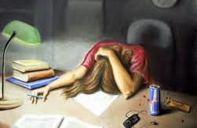
Students Lack of Study Skills
Created by: Daniel Matta
I.S. 528
dmatta@schools.nyc.gov

Slide 2
“A public policy is a government action usually intended to deal with a social problem…The six versions of the Public Policy Analyst (PPA) will guide you through the problem solving skills necessary to study historical and current American and global public policy issues.”

Slide 3
Public Policy Analysis
Define the problem
Gather the evidence
Identify the causes
Evaluate an existing policy
Develop solutions
Select the best solution
http://flippedtips.com/plegal/tips/welcome.html

Slide 4
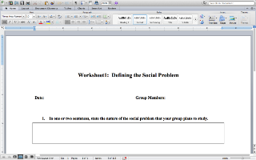
Step 1: Define the Problem
Students are constantly reminded to study for exams and given reviews or rubrics on what is going to be on the exam, but students still have trouble passing these exams. WHY?!?!?!?
Lack of studying or lack of the skills to study is a major issue that needs to be address.
Complete worksheet 1

Slide 5
What are some results that can come from not studying?
List at least 3.

Slide 6
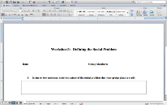
Step 2: Gather the Evidence
On our first math test, “Accentuate the Negative”, I asked, “How many people studied for the exam?”
70% of the students said they did not study for the test
After given an extra day 60% of the students did not study for the test
Give an explanation of why you think this is happening.
Complete worksheet 2

Slide 7
Step 3: Identify the Causes Why do students lack study skills?
List 3 more reasons why students do not study.

Slide 8
Step 3: Identifying the cause of the problem
What are some of the underlying reasons why people wait for the last minute to study?
Complete worksheet 3

Slide 9
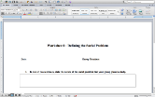
Step 4: Evaluate Policy
What are some policies that are put in place for you increase study habits?
Complete the worksheet 4

Slide 10
Step 5: Develop Solution
Come up with a couple of solutions that can help you become more consistent in studying.
Complete worksheet 5

Slide 11
Step 6: Select Best Solution
After working through step 5, What was the best solution you have discovered?
Complete worksheet 6

