Slide 1
Obesity in NYC schools Rosa m. luis Ps.28 Rosamarialuis@hotmail.com

Slide 2
PPA PROCESS
What is the problem?
Where is the evidence?
What are the causes?
What is the existing policy?
What policies can you create to correct the problem?
What is the best policy to correct the problem?
http://flippedtips.com/plegal/tips/welcome.html

Slide 3
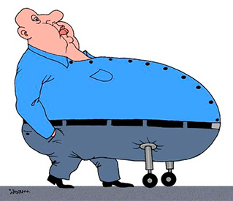
Defining obese and overweight
Overweight and obese are labels for weight ranges. According to the Centers for Disease Control and Prevention, weights in these ranges are higher than what is generally considered healthy for a given height. Having a weight in one of these categories may increase your risk for certain diseases and health problems. The definitions of overweight and obese are different for adults than children.

Slide 4
Causes of Obesity
Several factors contribute to obesity.
Eating unhealthy food is one way your child can accumulate added pounds. Elementary school cafeteria food is often mass-produced and chosen for its cost-effectiveness. While this can save the school money, the students suffer from foods high in carbohydrates, high in sugar, low in fiber and lacking in many of the recommended food groups.

Slide 5
Information about obesity in NYC Public Schools
More than one-third (33.8%) of public school students reported to the NYSDOH were overweight or obese, with 17.6% considered obese (Figure 1).
Rates of obesity are higher among public school students in middle and high school (18.2%) than among elementary school students (17.2%) (Figures 2 & 3).
An objective of the New York State Prevention Agenda 2013-17 is to reduce the percentage of children and adolescents who are obese from 17.6% to 16.7% by 2017.

Slide 6
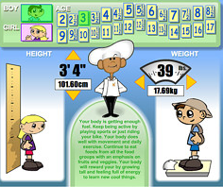
Existing policies
As a demonstration program, the Education Law requires Body Mass Index (BMI) and weight status reports for children in Kindergarten, 2nd, 4th, 7th, and 10th grades to be included in physical exams in certain targeted school districts;
Some areas of the State, including New York City; Albany; Schenectady; Suffolk; Ulster; and Westchester counties, require various types of nutritional information (such as calorie counts) is made available in restaurants;

Slide 7
Existing policies (2)
Eat Well, Play Hard programs through the Department of Health and Education to decrease television time, improve physical activity and promote healthy eating;

Slide 8
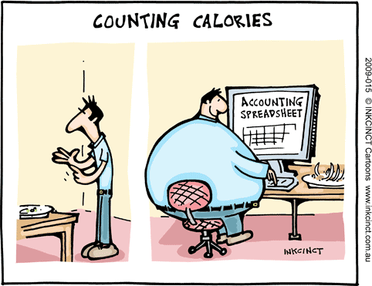
Evaluating an existing policy
Policy:
Some areas of the State, including New York City; Albany; Schenectady; Suffolk; Ulster; and Westchester counties, require various types of nutritional information (such as calorie counts) is made available in restaurants;
There are many places that includes calories count on the food or package. But if the consumer or students are not aware what does that mean or how to read the information facts it will be meaningless. If a person does not not how many calories a day she is supposed to each. They information will be just there to make the policy makers happy.

Slide 9
Some solutions
Providing students and parents with the knowledge and skills necessary to understand nutrition facts and to put it into practice.
Motivating students to be active on a daily basis every day not only at school, but also at home.

Slide 10
Students will complete this worksheet about the best policy solution.
http://www2.maxwell.syr.edu/plegal/tips/bestsol.html

Slide 11
Additional data on childhood obesity in the US and New York State is available at:
National Data: http://www.cdc.gov/obesity/data/childhood.html
NYC FITNESSGRAM Data: http://www.cdc.gov/mmwr/pdf/wk/mm6049.pdf
NYSDOH SWSCR Data: https://health.data.ny.gov/ and http://www.health.ny.gov/prevention/obesity/statistics_and_impact/student_weight_status_data.htm
Information about the New York State Prevention Agenda 2013-17 is available at:
http://www.health.ny.gov/prevention/prevention_agenda/2013-2017/
^{Contact:}
For more information about the data included and their specific implications for action, please send an email to DCDIPIFA@health.state.ny.us with IFA # 2013-5 in the subject line.
http://www.who.int/dietphysicalactivity/childhood/en/

