Slide 1
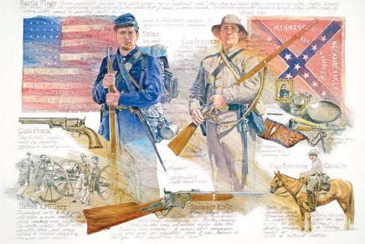
The American Civil War What Caused the Bloodiest Battles?
Kristin Nuñez (Ram)
Public School 128 M
kram@schools.nyc.gov

Slide 2
Essential Questions
Does conflict lead to change?
What social problem in America led to the Civil War?
To what extent did the Civil War lead to change in America?
Notes:
Inform students that we will be studying the Civil War briefly as an introduction to reading, Behind Rebel Lines. These are some of the questions we want to be thinking about before, during, and after we read.

Slide 3
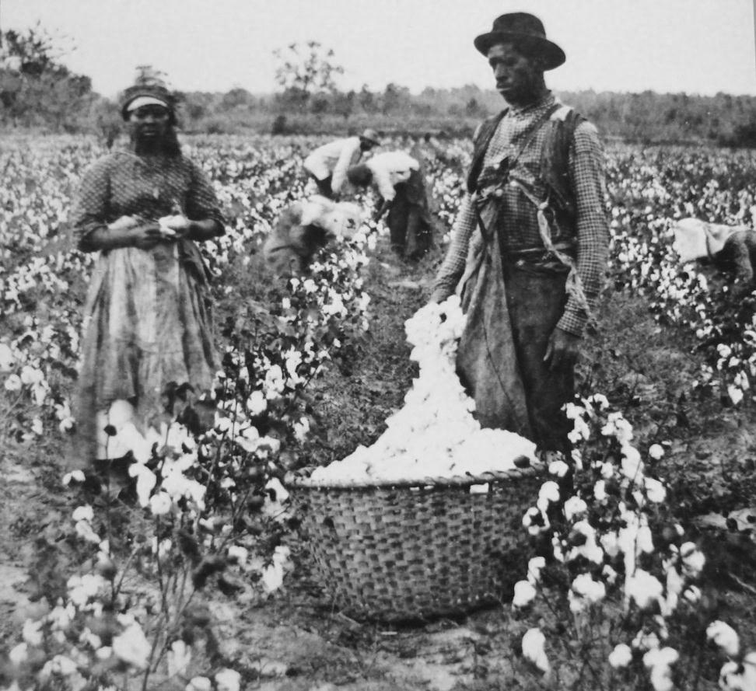
Could the North and South have compromised over slavery?
Step 1. What was the problem?
Notes:
Set up the background on the Civil War by analyzing photographs of slavery. What social problem existed in America? Why was this a problem?

Slide 4
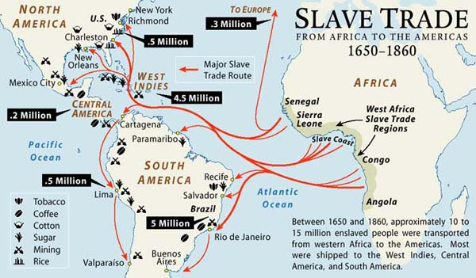
Let’s Look at Primary Sources!
Step 2. Gather the Evidence: What was slavery? What were the different viewpoints on slavery?
Notes:
Prompt students to use the Gather Evidence worksheet while looking at the following images of slavery through the link to the PPA. As we are looking through the images as a whole group (or in small groups with laptops), students will take notes on what they see and what it makes them think about the social problem of slavery.

Slide 5
The South (The Confederacy)
Southern families lived on plantations, where they grew crops like cotton and rice.
Since 1619, people were brought from Africa and sold as slaves to be used as workers on the plantations.
Southern plantation owners depended on slave labor.
The South was afraid that the government would take away their right to own slaves and set up their own rules.
Notes:
How did southern plantation owners justify the use of slaves? Why did the South “need” slaves?

Slide 6
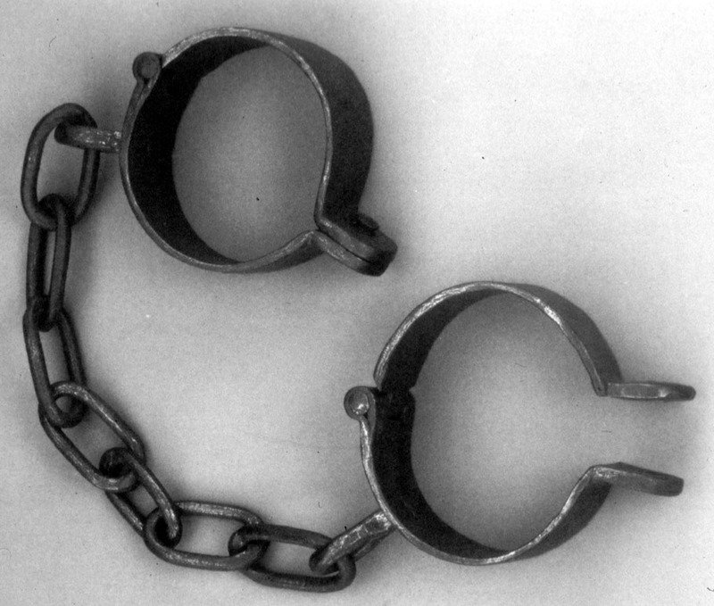
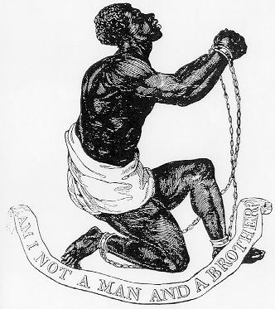
The North (The Union)
By the 1800s, there were still a few slaves in the North. For example, there were slaves used in New York State.
However, many Northerners believed it was not right to buy and sell human beings, and farming was not important or justifiable.
Notes:
What does “AM I NOT A MAN AND A BROTHER” mean? Why was this phrase used? How does this show the way most Northerners felt?

Slide 7
Images of Slavery
Notes:
Ask students to think and reflect on the gruesome images of slavery. Should anyone have been treated like this? How do these images make you feel? How were people from Africa treated? Based on the documents, lead students to think about the way African people were treated like property – they were owned.

Slide 8
Images of Slavery
Notes:
Ask students to think and reflect on the gruesome images of slavery. Should anyone have been treated like this? How do these images make you feel? Was slavery justifiable? As a human being, could you have justified slavery? Why or why not?

Slide 9
How did slavery begin?
Step 3. Identify the Causes
Notes:
Go to PPA: “Identify the Causes” to further define step and prompt students to think about causes based on evidence. Think about the different viewpoints of the North and South. Students should use evidence based terms (citing back to specific images).

Slide 10
Jamestown in 1619
Africans were brought to the colonies in 1619.
They arrived were sold by the Dutch to the English in Jamestown.
The 20 African men were sold as indentured servants.
Notes:
HISTORICALLY:
Looking back, slavery started hundreds of years before as a way of using men for labor.

Slide 11
Southern Plantations in 1830s
Notes:
ECONOMICALLY:
Eventually, by the 1830s, Southerners made money by growing and planting on plantations. As we noticed in the other images of slaves, the Southern plantation owners wanted to make PROFIT from their cash crops without paying for labor and thus, they bought and sold slaves to work for them.

Slide 12
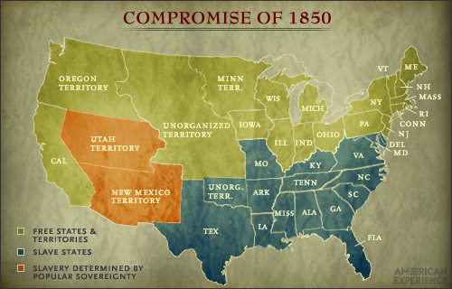
The Missouri Compromise
Notes:
LEGALLY:
Clearly, this was an issue in America – looking at the Missouri Compromise of 1820 – 1821 and, later, 1850, there was debate over whether or not slavery was just and where slavery was allowed or tolerated.

Slide 13
Important Vocabulary
secede
Definition:
Secede (verb)
to separate from a nation or state and become independent
Notes:
What problems may have started if states were allowed to secede? Why do you think Lincoln and the Northern States didn’t want this to happen?

Slide 14
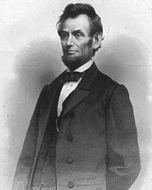
The Civil War Begins
Between November 1860 and March 1861, some states wanted to secede from the Union.
Abraham Lincoln is elected the new president in 1861.
Lincoln does not believe that the southern states should secede.
South Carolina withdraws from the Union and tries to take Fort Sumter.

Slide 15
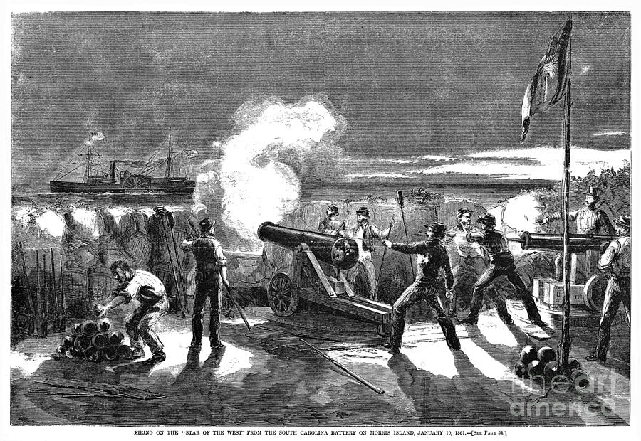
The Civil War Begins
Southerners felt the fort belonged to them, but Union soldiers would not leave.
Southern troops fired canons at the fort.
Lincoln orders the Northern troops to prepare for war.

Slide 16
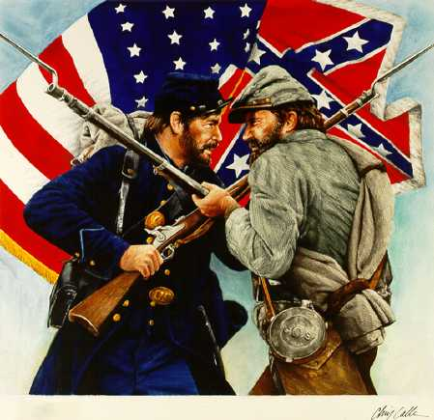
The Civil War Begins
The Union Vs. The Confederacy
Notes:
What social problem existed before the Civil War that eventually led to the war? Do you think that the war changed the social problem? In what ways?

Slide 17
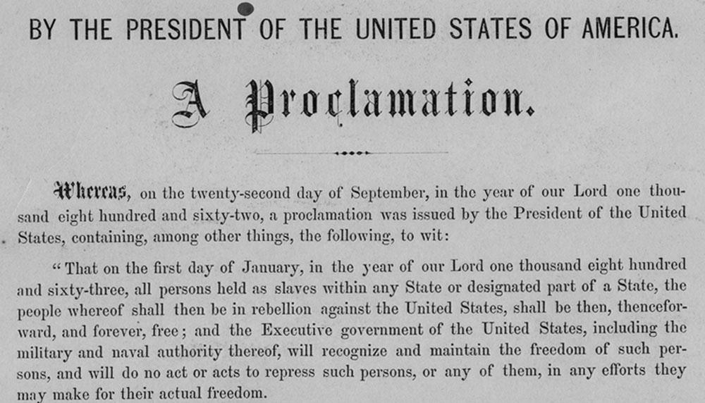
The Emancipation Proclamation
Step 4. Evaluate an Existing Policy
Notes:
What did the Proclamation mean? What was Lincoln’s purpose or goal in writing the Proclamation?
Note to teacher: During the war, President Lincoln issues the Emancipation Proclamation to free all slaves in the “slave states.” One cause for the Civil War was to keep the Union together, but the E.P. also made abolishing slavery a major goal for the North.

Slide 18
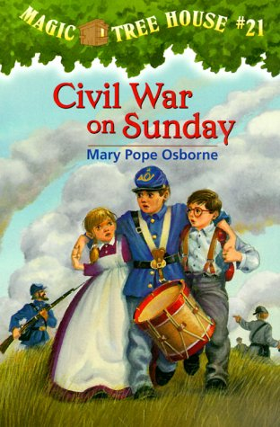
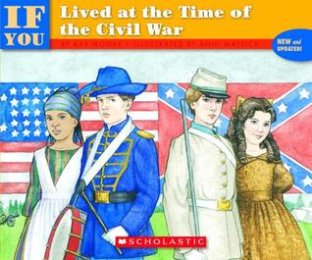
Citations and Further Reading

