Slide 1
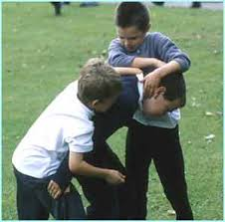
Bullying at P.S.28
Bullying In school
Teresa Marte
School P.S. 28
Email: terelb2008@hotmail.com
What is Bullying?
Who can be affected?
What are the causes?
How can we prevent It?

Slide 2
Bullying at P.S. 28
We will use the Public Policy Analyst steps to help us investigate the social issue.
1. Define the Problem
2. Gather the Evidence
3. Identify the Causes
4. Evaluate an Existing Policy
5. Develop Solutions
6. Select the best Solution

Slide 3
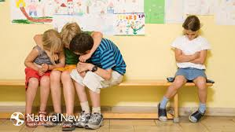
Define the Problem
Bullying: Is an aggressive physical contact, words or actions to cause another person injury or discomfort. People use physical strength to hurt others for different reasons. Also a use of superior strength or influence to intimidate someone that can not or thinks they can not stop it, typically to force him or her to do what one wants.
Now, think if there was a time where you ever felt like you were being bullied? Turn and talk to your partner. Share your experience.

Slide 4
Gather the Evidence
Have you ever being bullied at school?
Have you ever bully someone else?
Why do you think some students want to bully other students?
Public Policy Analyst: step 2
http://www2.maxwell.syr.edu/plegal/ppa/intro.html

Slide 5
Identify the causes
Why do you think bullies do this to other children?
What makes someone a bully?
What are different types of bullying?

Slide 6
Existing policy
How is bullying handle at PS 28
What do we do to prevent bullying?
Teach students what is bullying and why it is important to avoid it.
Offer counseling for the bully and the bulled.
Support anti-bully campaign.
http://www2.maxwell.syr.edu/plegal/ppa/intro.html
http://www.goodcharacter.com/

Slide 7
Develop Solutions
To stop bullying we can:
Make parents aware of the situation.
Educate students about the danger of bully.
Remind the person that they are hurting others.
Help students engage into positive activities.
http://www.stopbullying.gov/
http://kidshealth.org/

Slide 8
Select the best solution
Together we can find good solutions
Agree to keep a safe school.
Do not become a bully.
Do not look the other way when you see someone being bully.
Be respectful to others.

Slide 9
Bully Free School
At P.S.28 We want happy students!!
We care about each other!!

