Slide 1
Juvenile Diabetes: Too High in the Heights!
By: Mr. Badia
Our Lady Queen of Martyrs
llewbadia@gmail.com

Slide 2
What is diabetes?
Type 1 diabetes:
Type 2 diabetes:

Slide 3
Diabetes in the U. S.

Slide 4
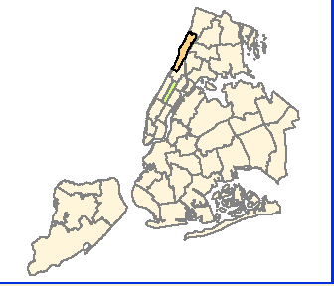
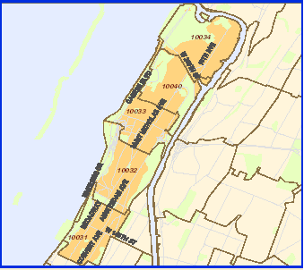
The Health of Washington Heights & Inwood – Manhattan Zip Codes: 10032, 10033, 10040, 10031

Slide 5
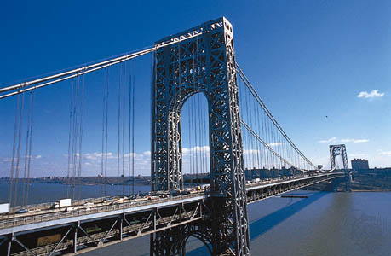
Juvenile Diabetes in Washington Heights.
Worksheet #1
Worksheet #2

Slide 6
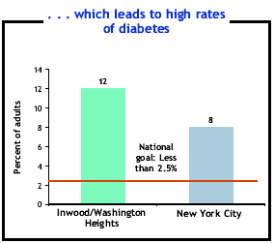
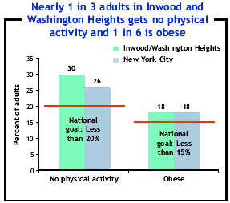
What are the causes in the rise in juvenile diabetes?
Being overweight puts people at risk for heart disease and many other health problems, especially diabetes. Latino children have the highest rate of obesity and inactivity; and are the predominant group in the Washington Heights area.
Worksheet #3

Slide 7
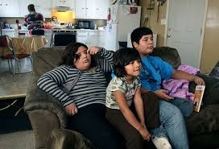
Social Problems:
Public Health Problem
Highest Among Hispanic School Children: affects academic and social success
Threat to Healthcare
Economic Problem
Moral and Social Justice

Slide 8
New York City Programs to Reduce Diabetes.
I. Efforts toward equitable access to nutritious food
School Food Plus
New York State Farmer’s Market Nutrition Program
II. Efforts to increase physical activity
North Manhattan Walk our Children Program
Shape Up New York
III. Improving quality and availability of health care
New York A1C Registry (NYCAR)
Visiting Nurse Service of New York’s Maternity, Newborns and Pediatrics

Slide 9
Institutional and Local Government Policy Responses:
The NYC Food Policy Task Force and Coordinator
The NYC Partnership for Food and Fitness
CUNY Campaign Against Diabetes
New York State Health Foundation
Band on Oversized Soft Drinks
Worksheet #4 Worksheet #5

Slide 10
Select Best Public Policy
Worksheet #6

