Slide 1
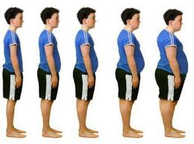
Public Policy Analyst The immediate and long-term effect of Child Obesity at P.S 128M The Audubon School
by Lissette Ureña
January 29, 2013

Slide 2
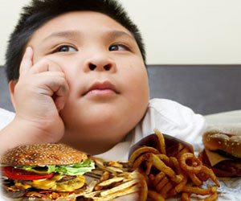
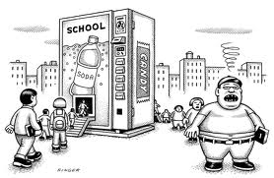
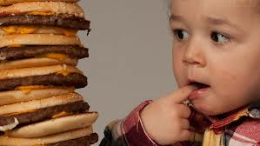
Step 1:Define the Problem
Child Obesity!

Slide 3
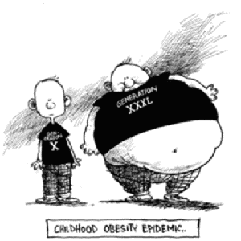
Which child do you think will run faster on a race?Why? Explain…

Slide 4
Step 2: Gather the Evidence
Accountable talk
Turn and talk to your partner about the type of snacks you see your classmates bring to our school during the snack time in your classroom or in the cafeteria at lunch time?
Make a list of the different food items that are brought to our school for snack:
________________
________________
Worksheet2: "Gathering Evidence of the problem"(HTML)

Slide 5
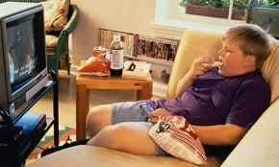
The immediate effect of Child Obesity!
http://www.cbsnews.com/video/watch/?id=682161n
I will show this video as an example of immediate effect

Slide 6
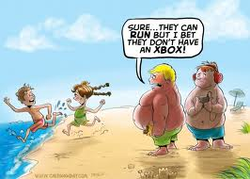
Step 3: Identify the Causes
Why are we seeing more and more overweighed students in our school through out the different grades?
Think about the reason why we are frequently seeing more students who are becoming overweigh.

Slide 7
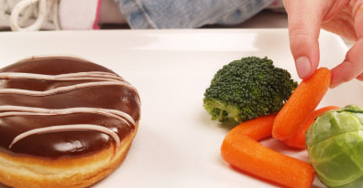
What are some of the reasons? Think and write some possible reasons
Junk food instead of healthy snacks
________________________________
________________________________

Slide 8
Step 4: Evaluate an Existing Policy
Lets revise our school policy and analyze what we need to continue doing , and what need to be change or improve in order to make it work better.
-With your partner turn and talk about news ideas that we can implement to our school policy.
*I will be writing their responds on a semantic web

Slide 9
What should we continue doing?
We should continue using the 15 minutes warm-up exercise cards in the classroom beside the gym periods.
Dance assembly programs
Girls and Boys Sport Days
(insert additional students respond)

Slide 10
What need to be improved?
The teachers’ consistency in following the school’s snack policy
More water fountains around the school
More parents’ collaboration in sending healthy snack for their children to eat
( additional students respond)
______________________________

Slide 11
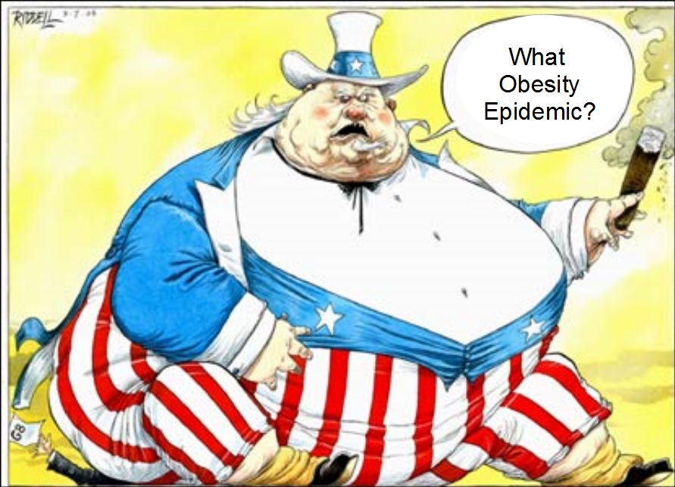
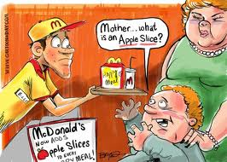

Slide 12
After revising our school policy…
How can our policy help us to improve the problem of obesity among our students?
Point #1.
Point #2.
Point #3.
Point #4.

Slide 13
Long Term Effect of Child Obesity!
Obesity's Impact On Children
November 3, 2008 4:13 PM
Many obese children are finding that they are taking an increased amount of medications for diseases like diabetes, asthma, and attention deficit disorder. Dr. Jon Lapook reports.
http://www.cbsnews.com/video/watch/?id=4568086n
I will show this video to the students

Slide 14
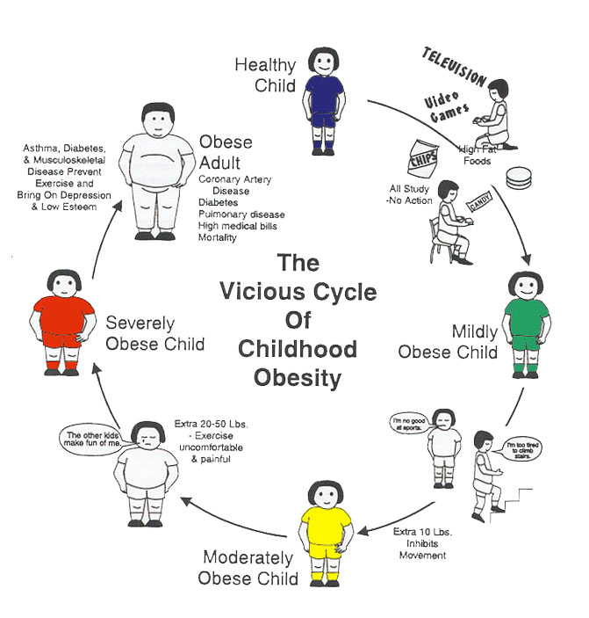

Slide 15
Step 5: Develop Solutions
Lets put our thinking cap on , and think about how can we solve this problem?

Slide 16
Step 6: Select the Best Solutions
Lets examine how can this problem of child obesity can be solved… Turn and talk to your group and come with possible solutions.
_________________________
_________________________
_________________________

Slide 17
(Feasibility vs. Effectiveness)
How Feasible is this going to be for our school to implement ? Is it going to be easy for the students and staff to put this solutions in practice?
Discuss with your team how can we make the solutions effective and productive?

Slide 18
Looking Forward
As a follow up, the students will research for other possible solutions to the problem for homework. Also, we will watch for the next class session the film Super Size Me.

Slide 19
You have done a magnificent job,
Now it is time to Think Ahead!
We will learn about the Let's Move! First Lady Michelle Obama’s initiative to combat childhood obesity, not only to solve the problem in our school as students, but also to extend our solution to help our community as productive citizens.
Click on the picture to read and learn more about Let’s Move initiative!

