Slide 1
Creating a Persuasive Essay
Using Public Policy Analysis to construct a persuasive essay

Slide 2
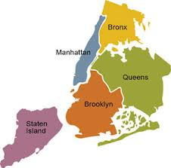
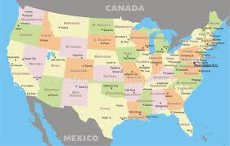
Define the Problem
What are social issues?
A social problem is a condition that at least some people in a community view as being undesirable.
http://www2.maxwell.syr.edu/plegal/TIPS/sp.html
Think about issues that you school, community, city or country is facing?

Slide 3
Define the Problem
In one sentence, write what the social problem that you will be investigating with your stance, and the location you will focus on.
What are at least 3 undesirable conditions that it creates? (Undesirable meaning something that is not wanted or disliked among many people)
Example: The problem is that people should not be allowed to smoke in public in New York City.
People are effected by second-hand smoke
Smoking causes a strong odor that is hard to get rid of
Smoking causes many diseases that are effecting many people in our city

Slide 4
Gathering Evidence & Identifying the Causes
Reliable Sources:
Reliable websites:
Statistics – facts and numbers that have been collected
Case Studies- a person you know
Surveys – questions asked to a specific group of people
Articles by experts
Websites ending in .org
National Geographic
Instagork.com
News outlet websites
NY Times
Washington Post for Kids
Huffington Post
Associated Press
Time for Kids
http://www2.maxwell.syr.edu/plegal/TIPS/gather.html

Slide 5
Gathering Evidence & Identifying the Causes
Examples:
National Geographic states that, “cigarettes contain almost 5,000 different chemicals, some of which come out of vehicle exhaust pipes,” - http://newswatch.nationalgeographic.com/2012/07/06/the-real-facts-on-smoking-and-public-health/
What type of evidence is this?
According to the article on www. cancer.org, “In the United States, the costs of extra medical care, illness, and death caused by SHS are over $10 billion per year.”
What type of evidence is this?

Slide 6
Evaluate a Policy & Develop a solution
The Advantages &The Disadvantages:
Evaluate how the policy is working
Effectiveness
Is it really working?
Costs
How much money? Cheap or expensive?
Enforcement
Are people following the policy or not?
Public acceptance
Do people like it?
Are we happy with this policy?

Slide 7
Evaluate a Policy & Develop a Solution
After the evaluating the policy,
do you think there should be a new one some changes?
Should we get rid of the policy completely?
Should just change a few things or add news regulations?
What should be taken out?
What should stay?
NEW RULE?

Slide 8
Convincing Others About Your New Solution
Debunking the Opposition:
The Counter Argument:
What might someone against your policy say?
Is it too expensive?
Will a lot of people not like it?
Would it be hard to make it work?
What would you say back to them to defend your new policy?
Back up your new policy with more specific evidence
TALK BACK WITH FACTS!

Slide 9
Concluding Your Persuasive Essay
Restate the social issue using different words
Restate your opinion in different words
Restate the new policy that should be in placed to correct the social issue
Add a final thought

