Slide 1
Pollution at PS 444 Louie Armstrong
What is the issue, what are the issues, and what can we do about it?
Created by Brent Nycz - January 29, 2013

Slide 2
Public Policy Analyst: Because we can create policy for others to follow!
Step 1: Define the problem!

Slide 3
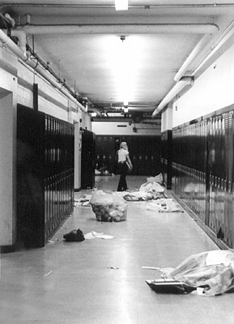
Pollution…?
Have you ever seen the hallways look like this?

Slide 4
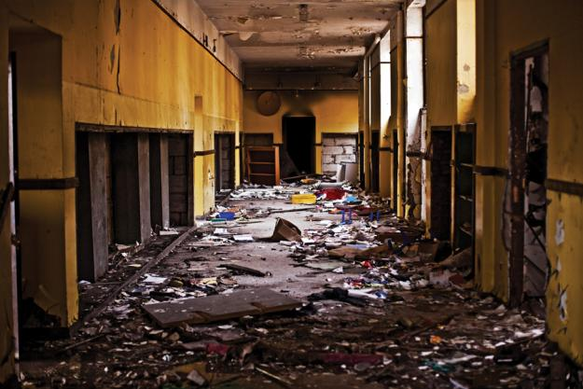
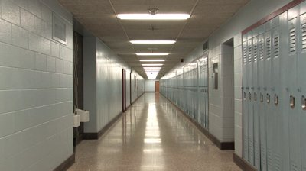
Do you think we have hallways that look like…
THIS ONE Or…
This one?

Slide 5
Public Policy Analyst: Because we can create policy for others to follow!
Step 2: Gather the Evidence!

Slide 6
In a small group, discuss…
What kind of trash do you see in our classroom, in our school, in the cafeteria, in the hallways, and outside on the playground?
Write your answers in your writing notebook.
Notes:
I will give out different locations for different groups to focus on.

Slide 7
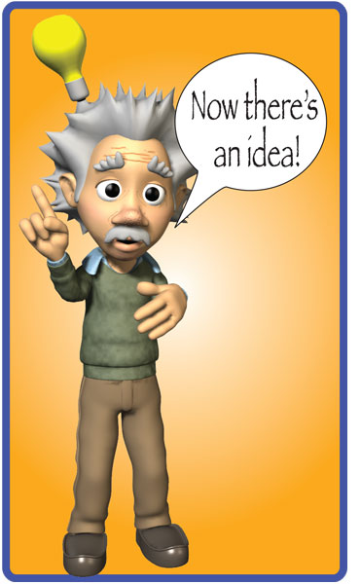
What did we come up with?
Bullet #1!
Bullet #2!
Bullet #3!
Bullet #4!
Bullet #5!
As you can see, I will be writing my students’ suggestions as they volunteer their ideas.

Slide 8
Public Policy Analyst: Because we can create policy for others to follow!
Step 3: Identify the Causes!

Slide 9
We know what trash we see, but…
WHY do we throw so much trash around?!?
What do you think?
Discuss why do we throw so much trash around!

Slide 10
What did you all come up with?
People are lazy?
Some people can’t find trash bins?
Trash bin signs are hard to read.
Include other reasons students come up with in this section as well!

Slide 11
Public Policy Analyst: Because we can create policy for others to follow!
Step 4: Evaluate an existing policy!

Slide 12
Now what? Let’s review what we already have at PS 444…
Insert what the adults in the school do here (custodian’s job).
Insert what the teachers and students do in class.
Insert what the cafeteria aides and classroom café aides do during lunch time.
That sounds fantastic!
But… does it work?
In your small group, discuss why or why not what we do is working.
When you have answers, please raise your hand and I will discuss with you.

Slide 13
What works?
Recyclers help keep what can be recycled in recycle bins.
Honors society has been a great help in reminding us to recycle.
Aides help us clean tables after lunch.
Add other answers here.

Slide 14
What DOESN’T work?
No one outside the school is reminded to clean up after themselves.
Recyclers don’t remind students to help clean up enough.
Aides cleaning up at lunch allows some students to make a big mess.
Insert other answers here.

Slide 15
With that all in mind, I have a question…
Should we even TRY to keep our school cleaner?
What are the benefits for having a cleaner school?
Go back in your groups to discuss!
Point #1.
Point #2.
Point #3.
Point #4.

Slide 16
Public Policy Analyst: Because we can create policy for others to follow!
Step 5: Develop solutions!

Slide 17
It’s time to think: How can we turn our school to look like…
THIS School and NOT…
This one?

Slide 18
For homework tonight!
In your writing notebook, write down a couple ideas of how we can make our school cleaner.
Think about what we as a class can do as well as the custodians, lunch aides, etc.
The best ideas can possibly be presented at the next Honors Society meeting!

Slide 19
Public Policy Analyst: Because we can create policy for others to follow!
Step 6: Select the Best Solution!

Slide 20
Let’s discuss! How do we solve this pollution problem?
1)
2)
3)
Notes:
I will choose the best three solutions suggested by the students and put some solutions to a vote after they are suggested. We will talk about what needs to be done to make these solutions happen!

Slide 21
Feasibility vs Effectiveness
Feasibility – is it easy for the school to put our solution into action?
Effectiveness – will our peers, adults, and others listen to our solution and do it?
Is our solution easy to put into place? Will our community follow through on it?
What do you think? Discuss your thoughts with your group.

Slide 22
What can we do to…
What can we do to make our solution easy to accomplish as well as have a strong impact?
This is where I would lead a discussion with my students on how we can set our policy into place.

Slide 23
Congratulations!
Notes:
We just made some policy!

