Slide 1
Global Warming
Gilberto Maurtua
P.S. 128 Audubon School

Slide 2
Define the Problem
What is global warming?
A gradual warming of the Earth's atmosphere reportedly caused by the burning of fossil fuels and industrial pollutants

Slide 3
Gather the Evidence
Complete this worksheet: PPA Step #2
http://www2.maxwell.syr.edu/plegal/TIPS/worksheet2.doc

Slide 4
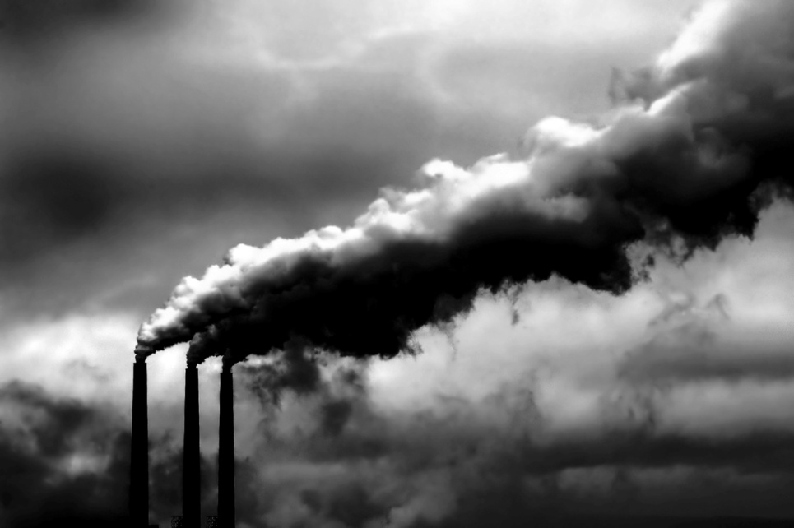
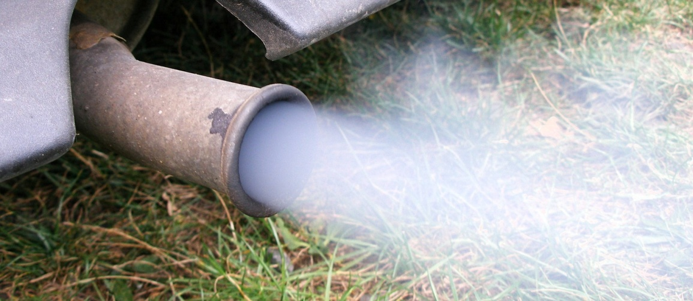
Causes of Global Warming
Carbon Dioxide Emission

Slide 5
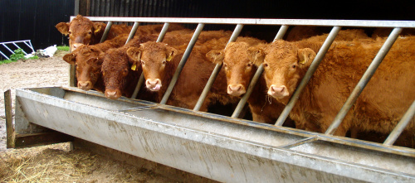
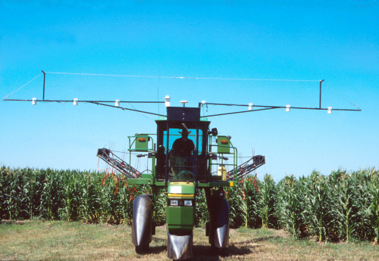
Cause 1. Methane emissions from animals, agriculture
Cause 2. Increase in usage of chemical fertilizers on croplands

Slide 6
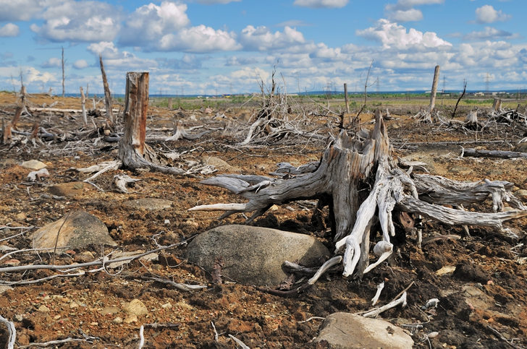
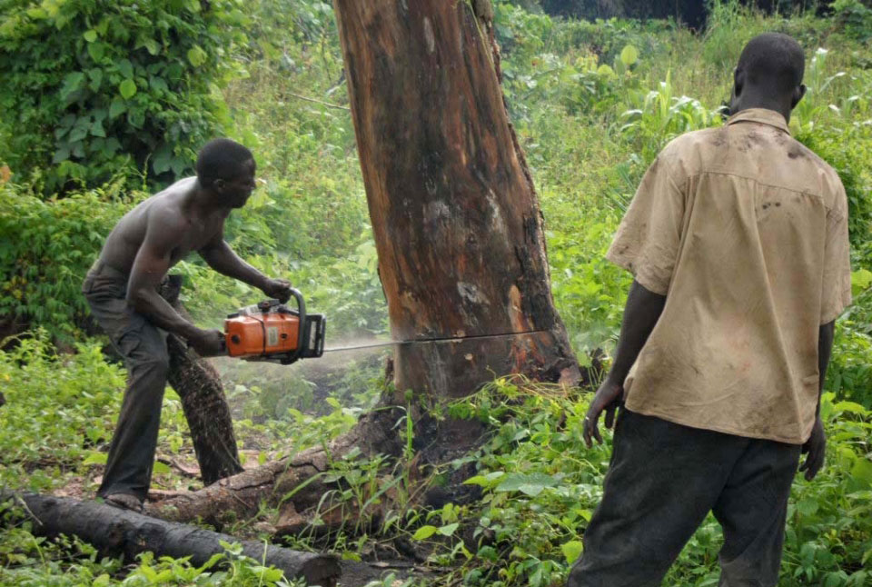
Cause 3. Deforestation

Slide 7
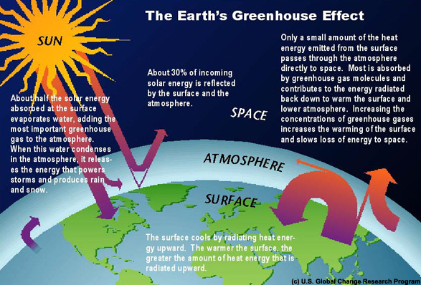
How it Affects the Planet
Greenhouse Effect

Slide 8
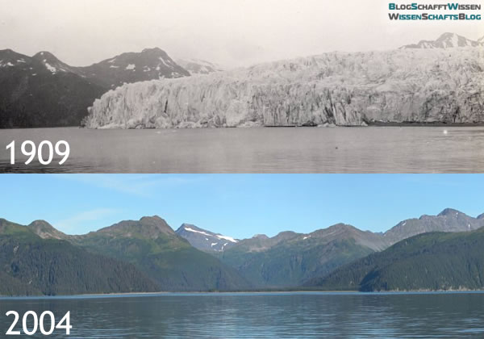
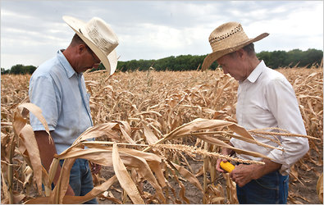
Green house Effect causes Melting Glaciers and Droughts

Slide 9
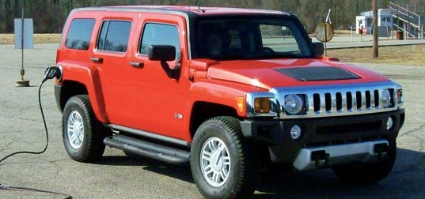
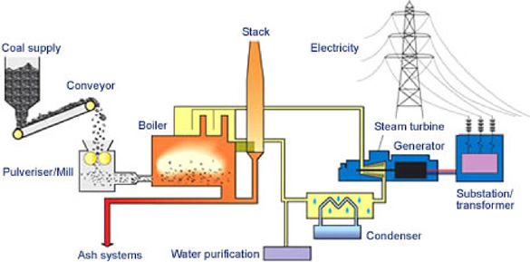
The present policies regarding the environment
1. Cars that are fuel inefficient... Gas guzzlers!
2. Coal burning plants

Slide 10

We must be proactive in our quest to save our planet.
The best solutions are on the following slides…….

Slide 11

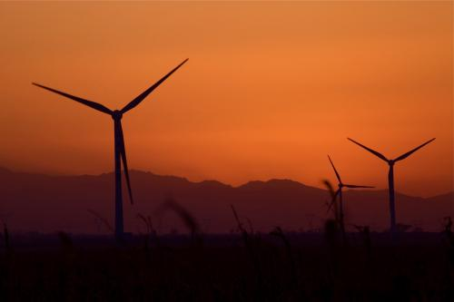
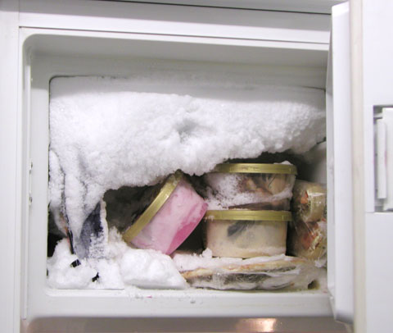

How can we stop global warming?
1. Plant a Tree
2. Choose clean power
3. Unplug your freezer
4. Change your light bulbs.

Slide 12
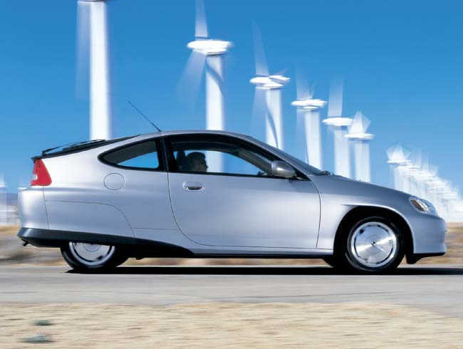

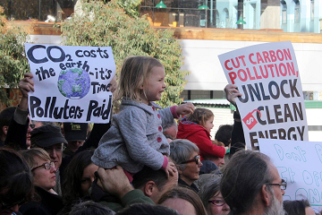
5. Buy a fuel efficient car
6. Look for Energy Star on products
7. Let policymakers know you are concerned about global warming

Slide 13

Let’s save our planet before it’s too late.

Slide 14
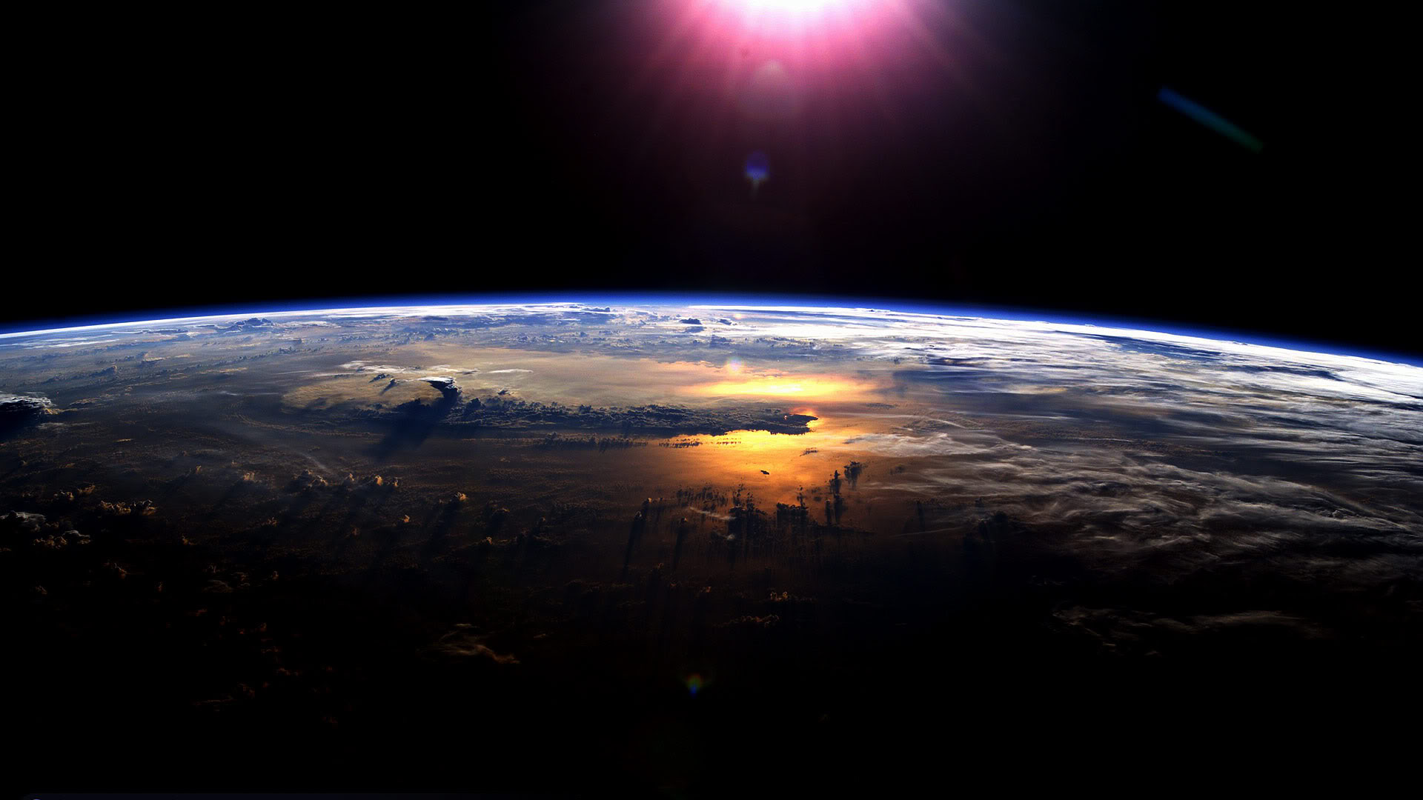
The End
Gilberto Maurtua PS128 Audubon School

