Slide 1
Energy Conservation Plan
PS/IS 10039
Donna Lennon – Student Government Advisor
February 4, 2013

Slide 2
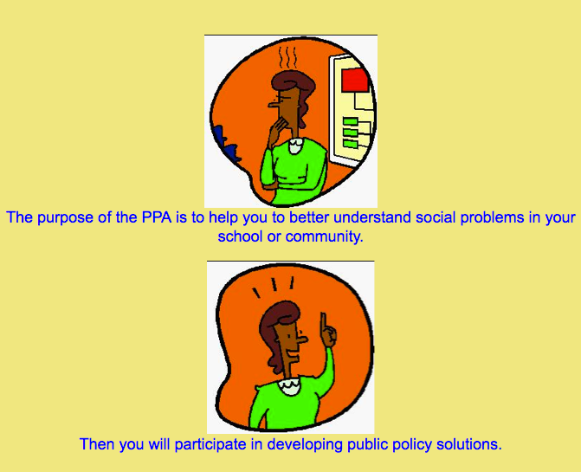
Solving a Social Problem Using Public Policy Analyst (PPA)
http://www2.maxwell.syr.edu/plegal/ppae/ppae2.html

Slide 3
According to a press release written by NYC Comptroller John C. Liu, “The DOE now consumes the most energy of all City agencies, with bills reaching $291 million a year.”
http://comptroller.nyc.gov/press/2012_releases/pr12-11-129.shtm

Slide 4
Step #1 Define the Problem

Slide 5
Our school is using too much energy!
The environment is important to us. Let’s save it by reducing our usage!

Slide 6
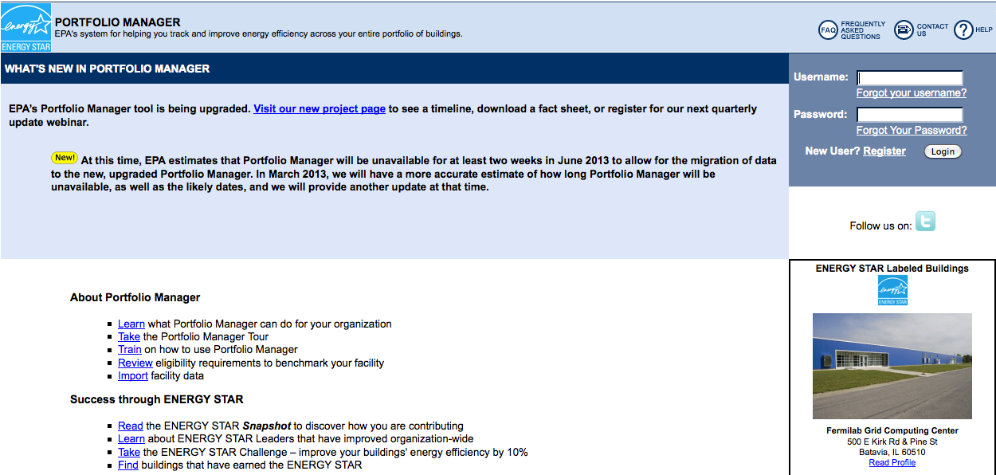
Step #2: Gather Evidence
Classroom energy audit by each student
Building energy audit by custodian
Energy Star Portfolio Manager

Slide 7
Step #3: Identify the Causes List things that we do in our school that waste electricity.

Slide 8
Step #4: Evaluate Existing Policy
We don’t have one!

Slide 9
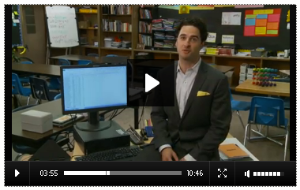
Step #5: Develop Solutions

Slide 10
How can we save energy?

Slide 11
Step #6: Select the Best Solution
Is it feasible?
Is it effective?
Can we start today?

Slide 12
Let’s save the Earth!

