Slide 1
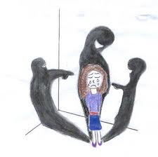
Public Policy Analyst
Bullying…Identify the Causes, Consequences and Route for Change
By Nancy Cande IS 528

Slide 2
What is Bullying
For the purpose of this PowerPoint I will focus on a specific type of bullying that occurs at my school.
Bullying can target the following: size, grade/age, , physical appearance, obesity,

Slide 3
Narrowing the Target
For the purpose of this PowerPoint I will focus on a specific form of bullying:
Repeated and targeted verbal aggression towards a student based on physical appearance.

Slide 4
Public Policy Analysis Steps
Define the problem
Gather the evidence
Identify the causes
Evaluate an existing policy
Develop solutions
Select the best solution

Slide 5
PPA Steps Highlighted Here Include:
Defining the problem
Identifying the causes
Developing Solutions

Slide 6
Causes of Cyberbullying
Peer pressure
Low Self Esteem
Insecurity
Anonymity
Lack of programs at school aimed at prevention
Lack of empathy

Slide 7
Causes of Cyberbullying-Continued
Victim of bullying
Lack of parental supervision
Victim of bullying
Lack of policy
Lack of consequences
Culture at large

Slide 8
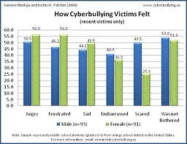
Cyberbullying Consequences
Low self esteem
Isolation
Physical altercation
Drop in grades
Dropping our of school

Slide 9
Recommendations for Public Policy
The first step can not be overlooked: KNOW THE POLICY!

Slide 10
Recommendations for Public Policy
The greatest impact for the success of any public policy’s implementation is public opinion and intervention!

Slide 11
The Public
The public is a group of individuals who have a capacity for implementing change!

Slide 12
Change
The more the public is aware of policies and it’s success or failure the more a policy’s impact can be evaluated and revised.

Slide 13
Protecting our Youth
We MUST be aware of what we, as a society are doing and not doing to protect our youth.
By all of us taking ownership in understanding current policy and making the needed revisions to it, we can begin to protect children from cyberbullying.

Slide 14
PPA Credits
Public Policy Analyst (PPA) guides you through the problem solving skills necessary to study historical and current American and global public policy issues. Since public policy affects all aspects of life, these skills can be used not only in social studies courses, but also in subjects such as science and language. PPA is based on a model developed by W.D.Coplin & M.K.O'Leary
Website: http://www2.maxwell.syr.edu/plegal/ppa/intro.html

Slide 15
Resources
http://www.bullying.co.uk/
It has links to advice for parents and children in general areas as well as in legal issues. There are also links to bullying policies, tips from former victims of bullying, and what to do if you are being bullied outside of school. We recommend the links to the problem pages for parents and children because they give real life examples of problems and advice. This site is good for children, parents, and teachers.

Slide 16
Resources Continued
http://www.cyberbullyhelp.com/
http://www.bullyonline.org/schoolbully/links.htm
http://www.stopbullying.gov/

