Slide 1
MAINTENANCE & CHANGES IN THE ECOSYSTEM
Project CRITICAL
By
Sandy Tamayo, Teacher, FDA

Slide 2
Pollution
Introducing to the environment substances that are harmful or poisonous effect.
The three major type of pollutions are
Land pollution
Air pollution
Water pollution

Slide 3
Land Pollution
The major sources of land pollution are
Solid waste
Pesticides
Fertilizers
Deforestation
Hunting and overfishing

Slide 4
What are the effects of Land Pollution
Causes the disruption of habitat, the distuption food chain and the loss of biodiversity.
Land pollution causes the contamination of underground water supply

Slide 5
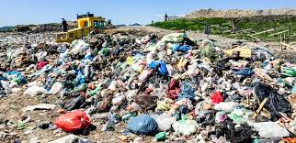
Land pollution

Slide 6
Air Pollution
The major sources of air pollution are
Littering
Burning of fossil fuel
Wildfire
Factories and industries
CFC Chloro-floro-carbon found in air conditioner, refrigerator, Hair spray

Slide 7
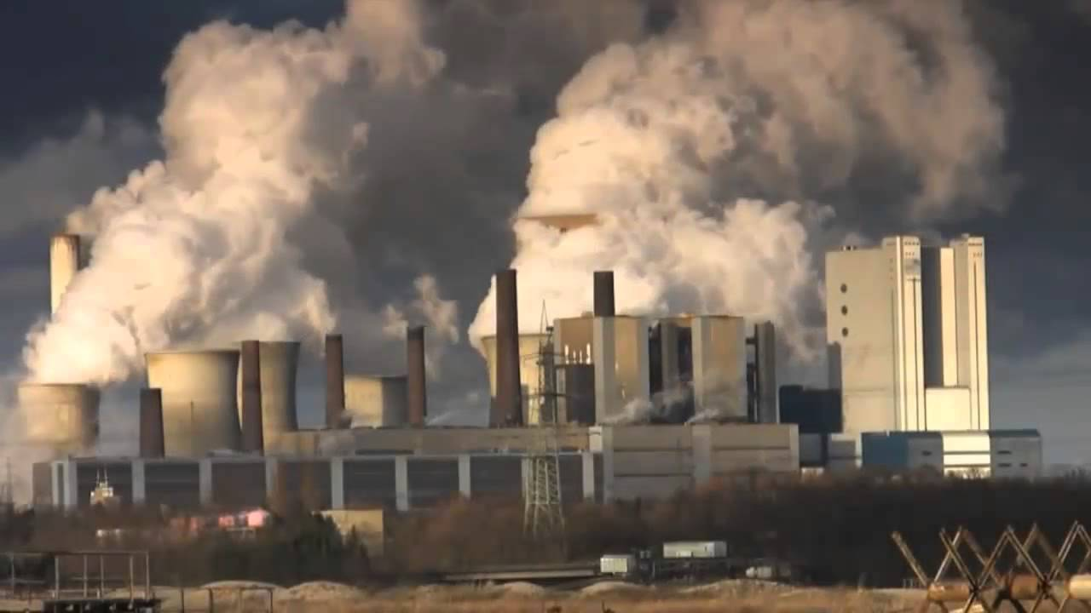
How industries and factories contribute to air pollution

Slide 8
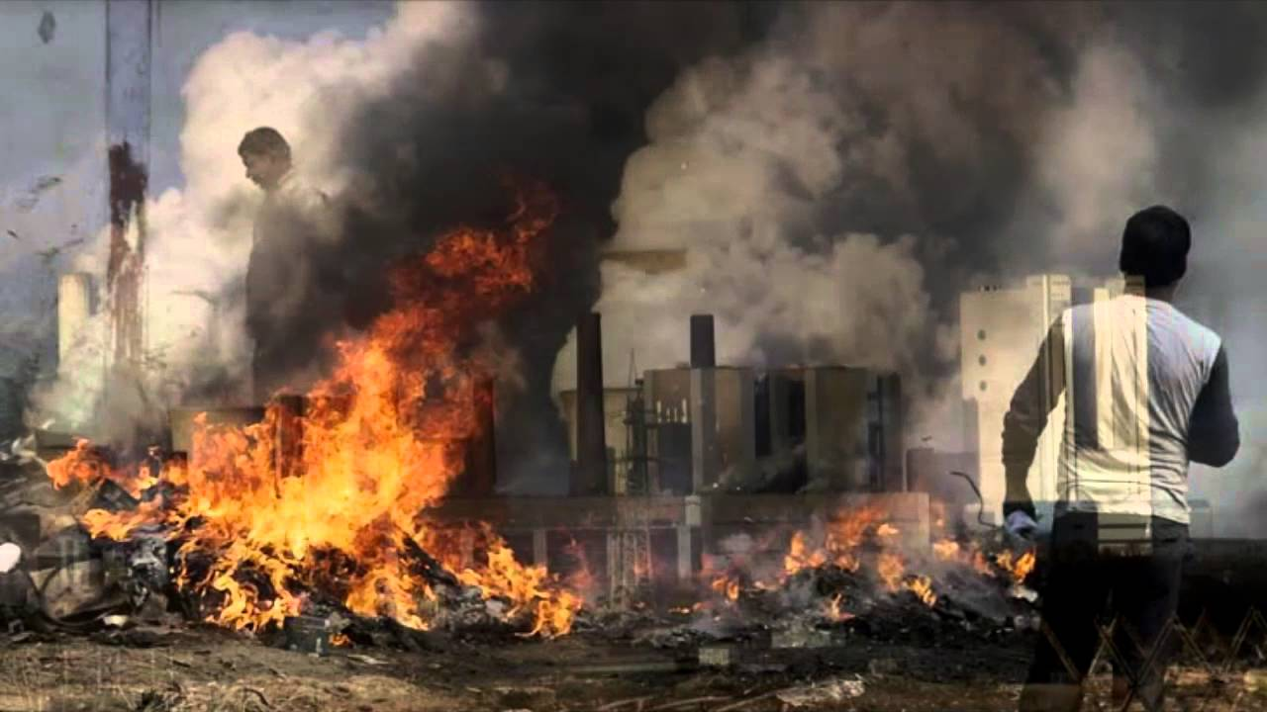
How the burning of garbage and wild fire contribute to air pollution

Slide 9
What causes Water pollution
Oil spills
Pesticides
Fertilizers
Organic waste
Inorganic chemicals
Disease causing microorganism
Changes in water temp
Radio active waste

Slide 10
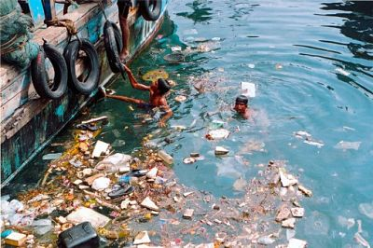
How solid waste contributes to water pollution

Slide 11
What are the effects of Air pollution
Causes the breakdown of the ozone layer that protects us against Ultra Violet light that causes skin cancer.
Increases the temp of the earth
Causes the green house effect
Global warming
Global warming causes the melt of the ice caps
Raising of sea level
Flood

Slide 12
Group activity
Students will be divided into water, land and air groups.
Students will brainstorm ideas and solutions to the pollution group.
Students will share their findings with other group and then share out with the whole class.

Slide 13
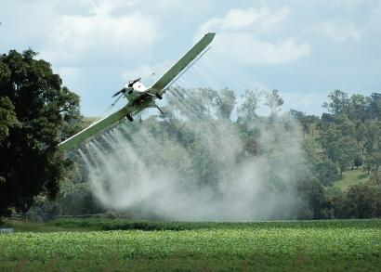
How pesticide contributes to water pollution

Slide 14
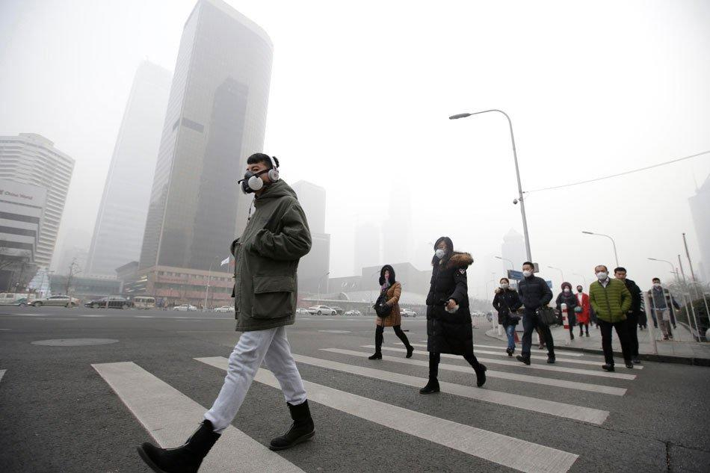
Manufacturing in China

Slide 15
What can we do as individuals to reduce the Pollution Problems
Use the information on the link below and then complete Worksheet 5 from the Public Policy Analyst
http://flippedtips.com/plegal/tips/solutions.html

Slide 16
What can we do as individuals to reduce the Pollution Problems
Use another type of energy instead of fossil fuel.
Car pool or Public transportation, Hybrid cars
Tougher Laws and fines, against illegal dumping and factories emission
Use of Natural predators instead of pesticides
Reduce Reuse Recycle

