Slide 1
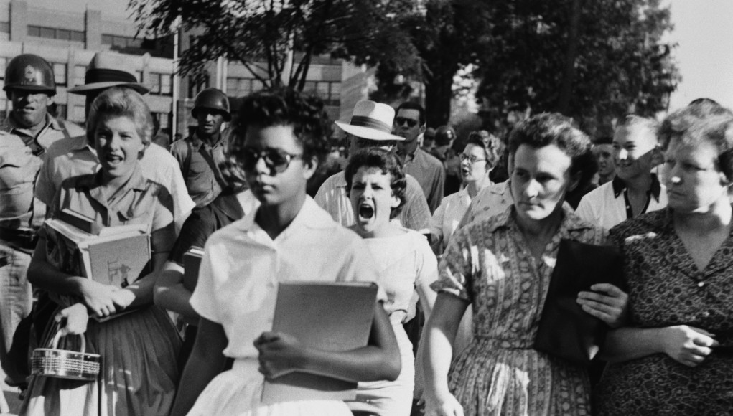
Lens of History: The Civil Rights Movement- Moving Away from Segregation
5th Grade Writing/Social Studies
Ms. A. Soto
Asoto22@schools.nyc.gov

Slide 2
The Steps of the AHPPA
As a class, we will be using the steps of AHPPA (American History Public Policy Analyst). The AHPPA will help us better understand the social problems that we will be studying throughout the school year. Below are the steps to the AHPPA:
Define the problem
Gather the evidence
Identify the causes
Evaluate existing policy

Slide 3
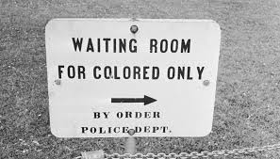
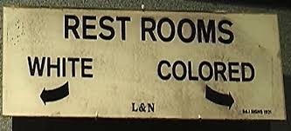
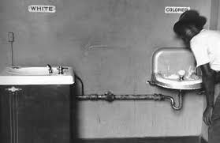
What is the problem?
During the late 1800s to the mid-1900s, African Americans living in the south had to endure unfair treatment due to the Jim Crow law, in U.S. history, any of the laws that enforced racial segregation.
It was during this time when African Americans couldn’t use the same bathroom or water fountain
They couldn’t visit the same restaurants or movie theater.
The children couldn’t even attend the same schools

Slide 4
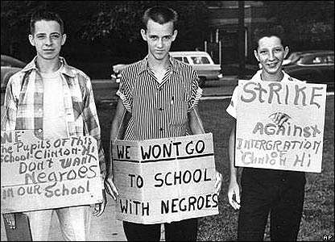
The Problem
Even though laws were passed to end segregation, many African Americans faced inequality especially in education.

Slide 5
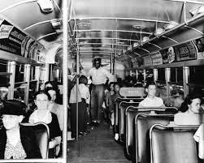
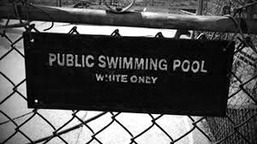
Gather The Evidence After completing your station activities over the last a couple of days, work with a partner to gather evidence using the following questions to guide you.
How did segregation shape the life of citizens during the Jim Crow era?

Slide 6
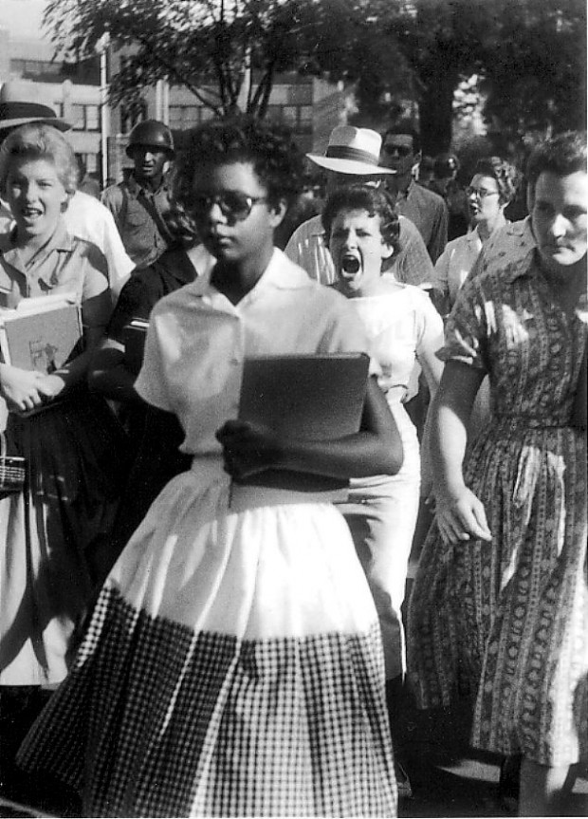
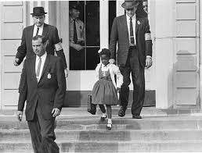
Identify The Causes
What forces (events, people, organizations perspectives) shaped the civil rights movement and the fight for integration?

Slide 7
Evaluate Existing Policy
1857- Dred Scott v. Sanford (Missouri) declared that all blacks– slaves as well as the free– were not and could never be citizens of the United States
1863- Emancipation Proclamation took effect
1865- Thirteenth Amendment to the U.S. Constitution abolished slavery.
1866- Civil Rights Act guaranteed equal rights under law for all people
1875- Civil Rights Act of 1875 guaranteed African Americans equal treatment in public accommodations, public transportation…

Slide 8
Jim Crow Laws (1876 – 1965) Laws that were created legalizing segregation by race.
Timeline of Legal Cases that had an impact towards the civil rights movement
Take a closer look at the cases that had an effect on civil rights during the segregation era of 1903.

