Slide 1
Police Brutality
Focus on Police Killing In the United States
S.Lee

Slide 2
What’s the big idea?
Police Killing: A case where a person dies as a result of being chased, beaten, arrested, restrained, shot, pepper sprayed, tasered, or otherwise harmed by police officers, whether on-duty or off-duty, intentional or accidental. https://mappingpoliceviolence.org/aboutthedata/
Notes:
Ask students to define police brutality?

Slide 3
Examining the Evidence
‘’African-Americans make up 13 percent of the U.S. population but account for 24 percent of people fatally shot by police. According to the Washington Post, blacks are ‘2.5 times as likely as white Americans to be shot and killed by police officers.’’’
987
people were fatally shot by police in 2017
2018
Source: Washington Post

Slide 4
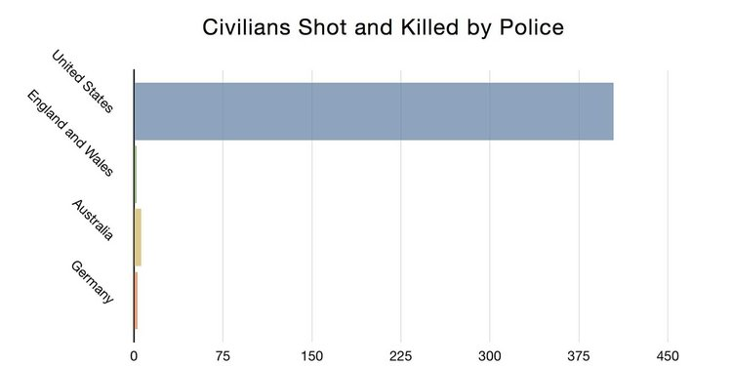
Examine the Evidence
In the world
This chart compiled by Business Insider shows police shooting statistics from 2011.
Notes:
What is the problem?

Slide 5
Identify the Causes
For example...
“What we see is a continuation of an unequal relationship that has been exacerbated, made worse if you will, by the militarization and the increase in fire power of police forces around the country,” says Pretzer.
“There’s a tendency to stereotype people as being more or less dangerous. There’s a reliance upon force that goes beyond what is necessary to accomplish police duty,” says Holmes. “There’s a lot of this embedded in the police departments that helps foster this problem.”
Read more: https://www.smithsonianmag.com/smithsonian-institution/long-painful-history-police-brutality-in-the-us-180964098/#2FEcRtAWrXc1lyVO.99

Slide 6
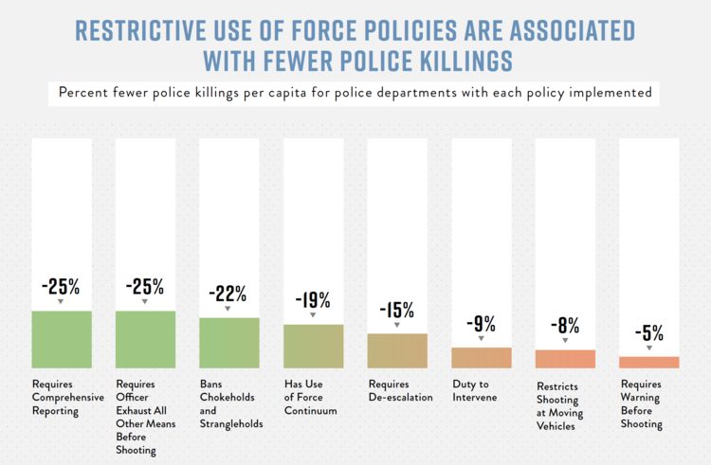
Evaluate Existing Policy
For example...
https://www.joincampaignzero.org/force/

Slide 7
Develop Solutions
Propose at least three new/original public policy alternatives. Be sure that all of your public policy alternatives are at the same geopolitical level as your social problem. Each alternative must specify the actual government or government agency that will carry out the proposed action. List the proposal that your group considers the most promising first.
What can we do about the problem?

Slide 8
Feasibility
Effectiveness
Effectiveness refers to the likelihood that your policy will produce results that lessen the social problem. To be able to anticipate the effectiveness, it is essential that your problem in step 1 is narrowly and specifically stated.
Feasibility refers to the likelihood that your policy would be enacted by the government or government agency. Feasibility can be affected by factors such as cultural acceptance and the anticipated costs in comparison to the benefits.
Policies that have a reasonable chance of being enacted (feasibility) are usually best, even if they have only moderate effectiveness.

Slide 9
Select the best solution by completing this matrix.
Notes:
Use names like Option 1, 2, and 3, to complete matrix.

