Slide 1
Kids and
Ms. Rodriguez
PS 200- The James McCune Smith School

Slide 2
What is nutrition?

Slide 3
What is nutrition?
Nutrition is the process by which the body nourishes itself by transforming food into energy and body tissues.
The science of nutrition concerns everything the body does with food to carry on its functions.
Food provides essential substances called nutrients.

Slide 4
Public Policy Analyst (PPA)
The 6 steps of the Public Policy Analyst (PPA)
1. Define the Problem
2. Gather the Evidence
3. Identify the Causes
4. Evaluate an Existing Policy
5. Develop Solutions
6. Select the Best Solution

Slide 5
What is the Problem?
Many children are NOT eating healthy and nutritious foods. As a result, they are having difficulties learning and concentrating in school.

Slide 6
Let’s talk about SOLUTIONS!!!
What choices can you make that help you stay healthy?

Slide 7
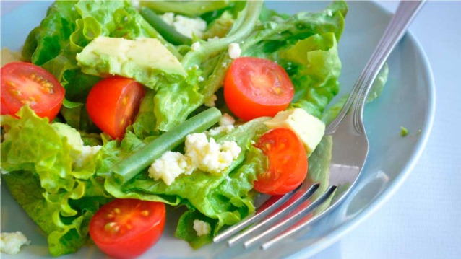
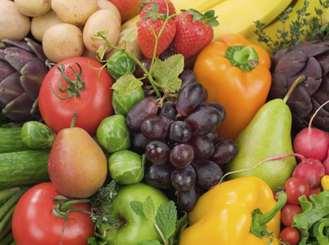
Healthy Foods
Look at the pictures. What are healthy foods? How do you know?

Slide 9
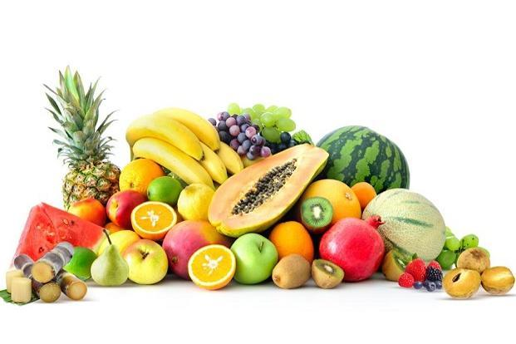
Everything you eat and drink matters. Our bodies need healthy foods. Food Groups Click on the different Food Groups to learn more!!!!
Fruits: Fuel Up With Fruits at Meals or Snacks Pears, watermelon, plums, raisins, berries, and applesauce (without extra sugar) are just a few of the great choices. Make sure your fruit juice is 100% juice.
Vegetables: Color Your Plate With Great Tasting Veggies Try to eat more dark-green, red, and orange vegetables, and beans and peas.

Slide 10
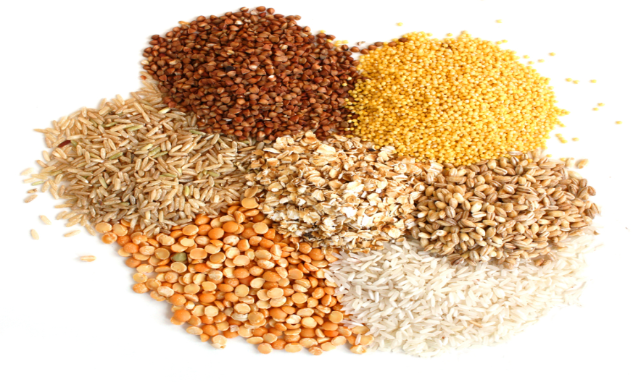
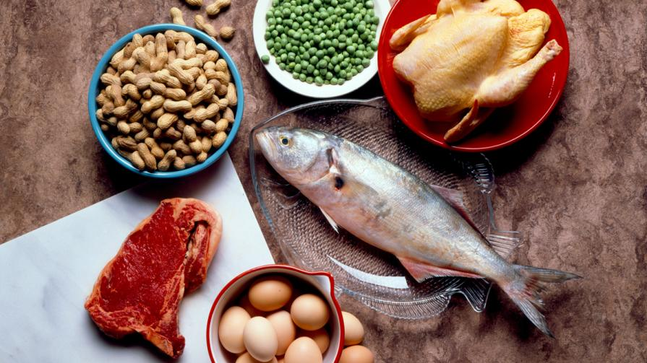
Grains: Make at Least Half Your Grains Whole Grains Choose wholegrain foods, such as whole-wheat bread, oatmeal, whole wheat tortillas, brown rice, and popcorn, more often.
Protein: Vary Your Protein Foods Try fish, shellfish, beans, and peas more often. Some tasty ways include a bean burrito, hummus, veggie chili, fish taco, shrimp stir-fry, or grilled salmon.

Slide 11
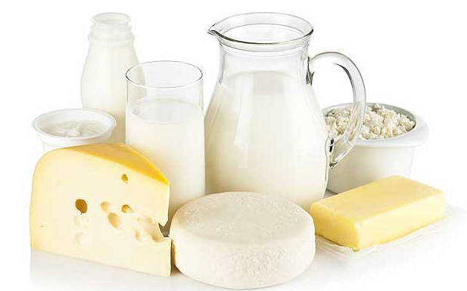
Dairy: Get Your Calcium-Rich Foods Choose fat-free or low-fat milk, yogurt, and cheese at meals or snacks. Dairy foods contain calcium for strong bones and healthy teeth.
Oils: Oils are part of healthy eating styles because they provide nutrients for the body, like fatty acids and vitamin E. They also enhance the flavor of your food. Some oils are eaten as a natural part of the food such as in nuts, olives, avocados, and seafood. Other oils are refined and added to a food during processing or preparation such as soybean, canola, and safflower oils. Choose the right amount of oil to stay within your daily calorie needs.

Slide 12
What is the BEST SOLUTION for YOU!!!
Why is it important to eat a variety of foods from all food groups?
What are “sometimes” foods? Why are they called that? What can I eat instead?

Slide 13
Create your OWN PLATE!!!
Select fruits and vegetables from the platter. Make sure you pick from each food group. Have fun and eat healthy!

Slide 14
Sources:
https://fns-prod.azureedge.net/sites/default/files/tn/sump_level2.pdf
https://www.choosemyplate.gov

