Slide 1
Urban Littering Jerome Norris jNorris3@schools.nyc.gov C.S..200 – The james McCune Smith School

Slide 2
Public Policy Analyst (PPA)
1. Define the Problem
2. Gather the Evidence
3. Identify the Causes
4. Evaluate an Existing Policy
5. Develop Solutions
6. Select the Best Solution

Slide 3
WHAT IS LITTERING??
Littering is throwing away garbage in public or other improper places other than trash cans or other areas for it’s right disposal.
As public policy analysts, who also live in an urban environment, you’ve identified this issue as one that you’d like to find a solution to. But before you go further, being able to define exactly what littering does, will help to better understand the issue that you’re investigating. This short presentation will help you discover more about the effects of littering by teaching about how items that people throw away, can affect our natural environment in the communities where we live.

Slide 4
Defining the Social Problem Date: March 5, 2017 Group Members: Nassa K., Tyquan J., Ricky W., Nataly M., Ariana C. Mouhammadou D., Nicolas B., Jessiah H., Jaquan M. Our group identified urban littering as the social problem they’d like to investigate and learn more about. They chose this issue among a pool of other probems because it’s something they often experience, don’t feel good about it and believ in their ability to be able to come up with a solution. List at least three undesirable social conditions that result from this problem: 1.Unattractive neighborhood 2.Negative self-image connected with being residents of litter affected neighborhoods. 3.Feeling of social limitations (comfortable community, play, etc.) because of littered environments. SUMMARY Inner-city (urban) communities suffer from excess littering due to a greater population sizes and a growing indifference to living in littered and cluttered environments. Community residents also have become too dependent on the NYC Sanitation Department to solve all their Littering issues. http://flippedtips.com/plegal/tips/select.html

Slide 5
DEFINE THE PROBLEM
We know that our urban communities have a big problem with people littering, but understanding what littering actually does to our environment, makes us better learn why this issue is so important.
While no type of littering is good for communities, there are two types, littering that can:
Decompose naturally in nature over time
Cannot decompose naturally in nature over time and can even harm natural environments

Slide 6
Now, we will see the following slides of different things that sometimes people create litter of when they’re done with them. As we do, think about the following questions:
What makes these things either easier or harder to break-down (decompose), back into soil and water, once people have finished with them?
Will these things be:
LIKELY or UNLIKELY
to
DECOMPOSE

Slide 7
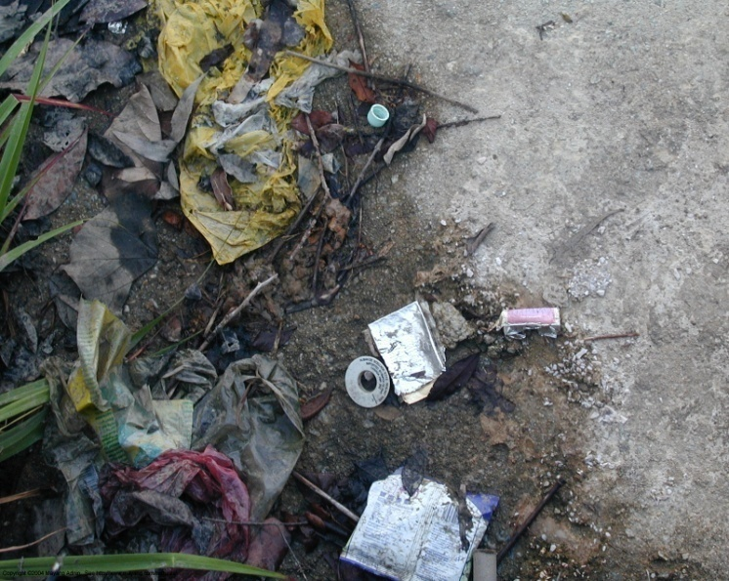
Decomposition of Litter
LIKELY or UNLIKELY?
Notes:
Jerome Norris Class 2-211

Slide 9
LIKELY Products from nature will always decompose
Notes:
Decompose definition as the natural breaking down of any organic (natural)/living thing, when its life-cycle is over.

Slide 11
LIKELY Newspapers are made from the pulp of trees

Slide 12
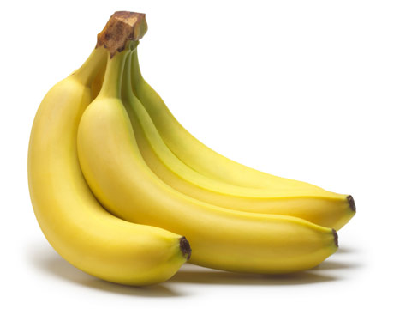

Slide 13
LIKELY Products from nature will always decompose

Slide 14
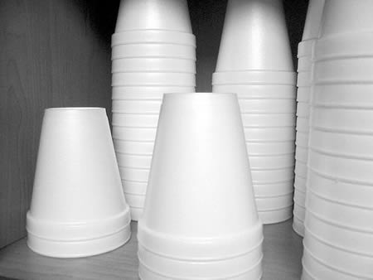

Slide 15
UNLIKELY Contains no natural products and will NEVER decompose

Slide 16
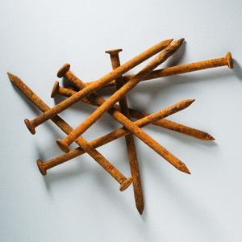

Slide 17
LIKELY eventually nails will rust and decompose!

Slide 18
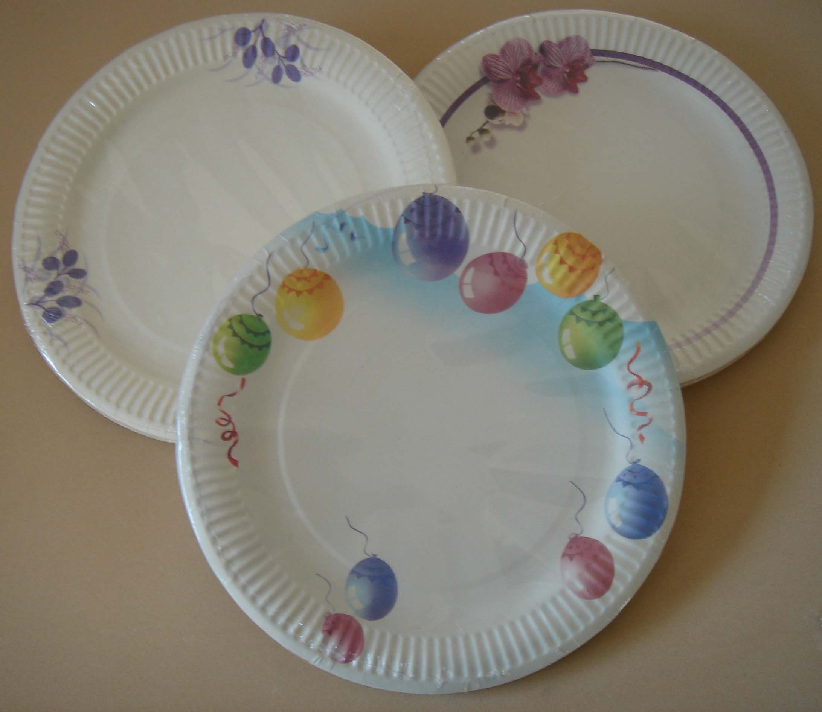

Slide 19
LIKELY paper plates are made from the pulp of trees

Slide 20
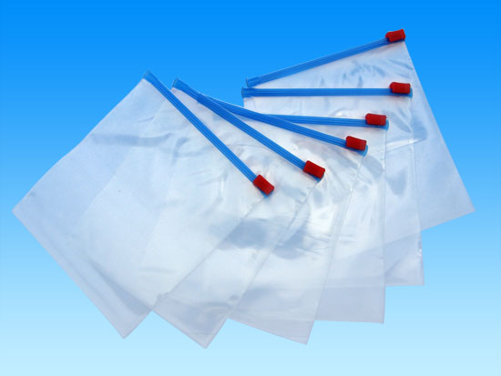

Slide 21
UNLIKELY plastic NEVER decomposes

Slide 22
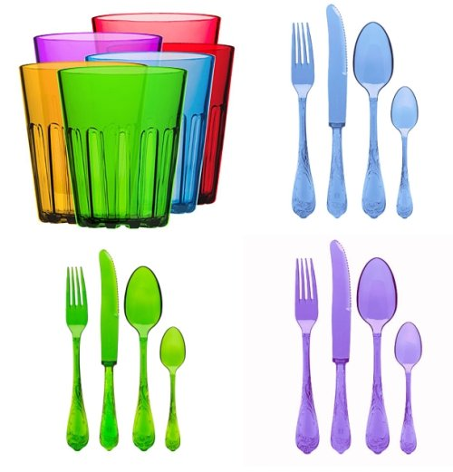

Slide 23
UNLIKELY plastic NEVER decomposes

Slide 24
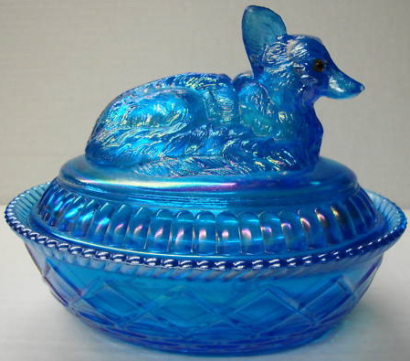

Slide 25
LIKELY Sand is a natural product of glass….eventually glass will decompose although it will take thousands of years
Notes:
* complicated

Slide 26
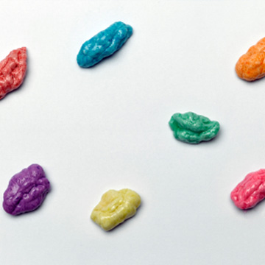

Slide 27
UNLIKELY gum NEVER decomposes

Slide 28
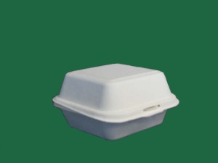

Slide 29
UNLIKELY Styrofoam NEVER decomposes

Slide 31
LIKELY clothing is made from the cotton plant

Slide 32
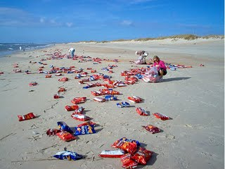
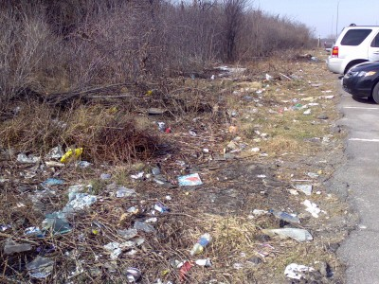
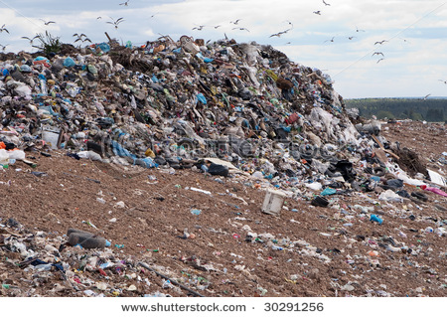
If so many things decompose is it okay to litter??
NO!
Although products such as newspapers, clothing, glass, cardboard, and nails are LIKLEY to decompose it can take thousands of years to break down and become soil!
Reduce, Reuse, Recycle…or
Notes:
Now that we’ve defined the problem of littering more clearly, we can go on to our next part of the investigation: gathering evidence of littering.

Slide 33
SOURCES http://www.mothernatured.com

