Slide 1
Stop bullying
Why people bully and ways to stop it.

Slide 2
Aim: Explore the reasons people bully and ways to stop it

Slide 3
Watch the following clip: Together Against Bullying
https://youtu.be/xUoe8ZSBGvc
The animated video is created from student drawings and writing, brought to life with the voices of youth. It poignantly provides insight into how painful bullying can feel, but also touchingly shows that kids want it to stop and want to be part of the solution.

Slide 4
Have you or someone you known ever been bullied? Or … Have you ever bullied Someone else? In either case, how did you feel? What Caused it to happen? what could have been done differently? Share with a partner about your experiences

Slide 5
What is Bullying and why is it a problem? Research the issue!
Write down what you know about bullying.
Write down what questions you have about bullying.
Click on the following link: https://www.stopbullying.gov/media/facts/index.html
Write down what you learned about bullying.

Slide 6
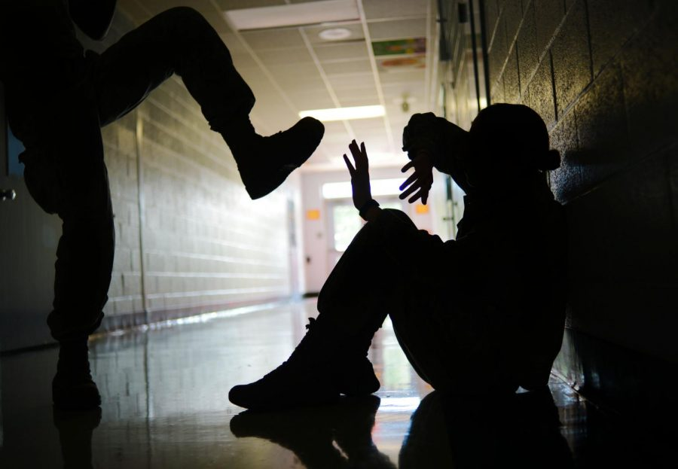
Why do people bully in the first place?
Go to the following website using the link provided: https://www.medicinenet.com/bullying/article.htm#what_makes_a_bully_why_do_kids_bully_why_do_adults_bully
Read the text.
Identify 2 reasons for why someone might
bully someone else.

Slide 7
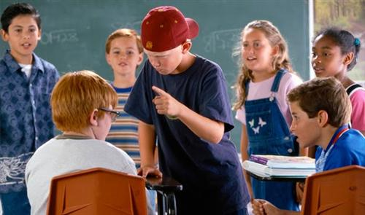
What are the different types of bullying?
Directions: Look up the following types of bullying and write a description of each one.
Physical Bullying
Verbal Bullying
Relational Aggression
Cyberbullying
Sexual Bullying
Prejudicial Bullying

Slide 8
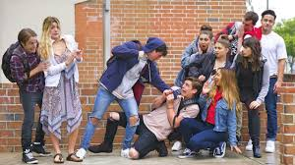
Evaluate the existing policy
Next work with a partner to find out the answers to the following questions.
What are the steps that your school has to stop bullying?
What are the steps the state has to stop bullying?
What are the steps the country has to stop bullying?

Slide 9
IDENTIFYING THE EXTENT OF THE PROBLEM IN OUR SCHOOL
Gather evidence: Interviewing Your Classmates
- Interview at least 5 classmates and use the following questions to guide your interview.
What is bullying?
Do certain social groups get bullied more than others?
Is there some kind of system in place that teaches students how harmful bullying can be? If not, what should it be?
What is the role of parents, teachers and administrators when bullying becomes a problem? What is the role of any students who are aware of bullying?
What should bullies and those being bullied do to solve the problem?

Slide 10
WHAT ARE SOME GOOD WAYS TO STOP A BULLY?
Some of the following solutions below are not appropriate ways to stop a bully. Think, pair, share which ways would not be appropriate in your groups and why these ways would not work.
Tell a parent, teacher, or an adult you trust.
Think that it is your fault, you deserve it, and that the bully will “just go away”.
Walk away calmly tell the bully to stop.
Travel with your friends or stay in a group.
Fight back.
Skip school, clubs, sports, or activates to avoid the bully.

Slide 11
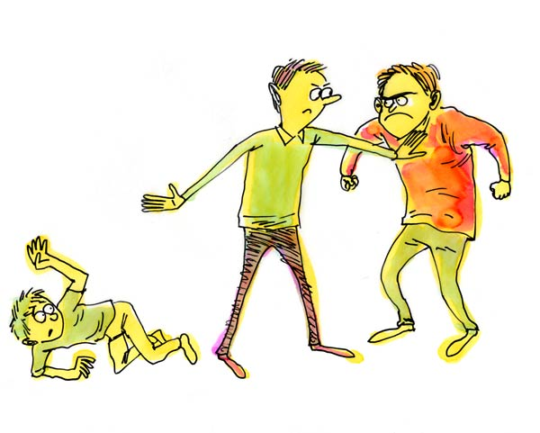
DEVELOP SOLUTIONS
Take some time to consider and research three solutions with your team.
Think about practicality vs. usefulness to identify the best solution in your groups.

Slide 12
SELECT THE BEST SOLUTION!
Next use the website Fodey to create a short newspaper article informing your audience about the issue. Include a definition of bullying. The link is attached below:
https://www.fodey.com/generators/newspaper/snippet.asp
Finally with your team, write a one page proposal about the best solution.

