Slide 1
HOW DOES TEMPERATURE VARY FROM PLACE TO PLACE ON THE EARTH?
By james Bramble
Frederick Douglass academy i

Slide 2
Some places are hot!

Slide 3
Some places get very cold!

Slide 4
Some places experience great weather all year round!

Slide 5
Problem: What kinds of crops can be grown in the Northeastern portion of the United States?

Slide 6
Because of the great temperature variations in the Northeaster portion of the United States, what kinds of crops would grow best in these environments? Visit the following websites for information. https://www.sare.org/Learning-Center/Books/Crop-Rotation-on-Organic-Farms/Text-Version/APPENDIX-1-Characteristics-of-Crops-Commonly-Grown-in-the-Northeastern-United-States http://www.northern-crops.com/crops2/ Do the crops in the following slide grow in such varied climates? If so, then why?

Slide 7
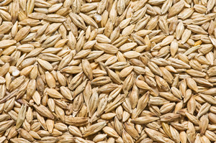
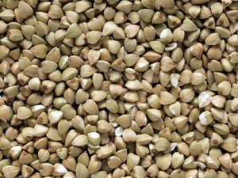
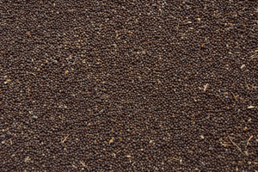
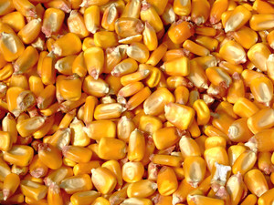
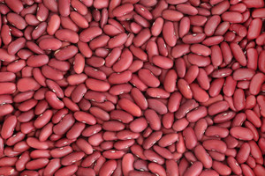
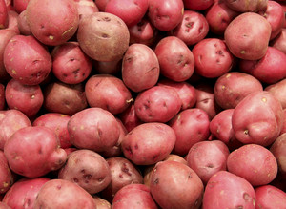
\ Barley Buckwheat Canola Corn Dry Edible Beans Potatoes

Slide 8
You are Public Policy Analyst and you will use the first three steps of the Public Policy Analyst policy to answer these questions. The accompanying steps and websites will assist you. 1. IDENTIFY THE PROBLEM http://flippedtips.com/plegal/tips/select.html 2. GATHER EVIDENCE http://flippedtips.com/plegal/tips/gather.html 3. IDENTIFY THE CAUSES http://flippedtips.com/plegal/tips/identify.html

Slide 9
The following slides will explain why the temperature varies so much in the Northern United States. Your job will be to identify what crops survive these climates and why.

Slide 10
It’s caused by the Angle of Insolation (Incoming Solar Radiation). This is the angle that the Sun’s rays are striking the Earth’s surface.

Slide 11
It’s caused by the Angle of Insolation (Incoming Solar Radiation). This is the angle that the Sun’s rays are striking the Earth’s surface. The Angle of Insolation is affected by:

Slide 12
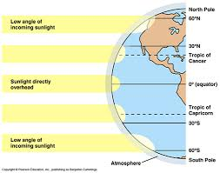
It’s caused by the Angle of Insolation (Incoming Solar Radiation). This is the angle that the Sun’s rays are striking the Earth’s surface. The Angle of Insolation is affected by: a. Latitude

Slide 13
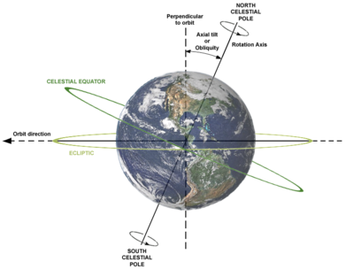
It’s caused by the Angle of Insolation (Incoming Solar Radiation). This is the angle that the Sun’s rays are striking the Earth’s surface. The Angle of Insolation is affected by: a. Latitude b. Rotation of the Earth

Slide 14
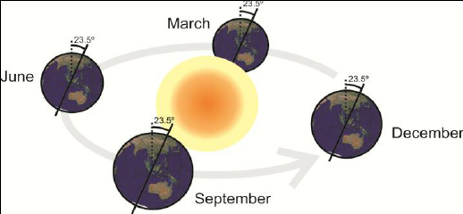
It’s caused by the Angle of Insolation (Incoming Solar Radiation). This is the angle that the Sun’s rays are striking the Earth’s surface. The Angle of Insolation is affected by: a. Latitude b. Rotation of the Earth c. Revolution of the Earth (Seasons)

Slide 15
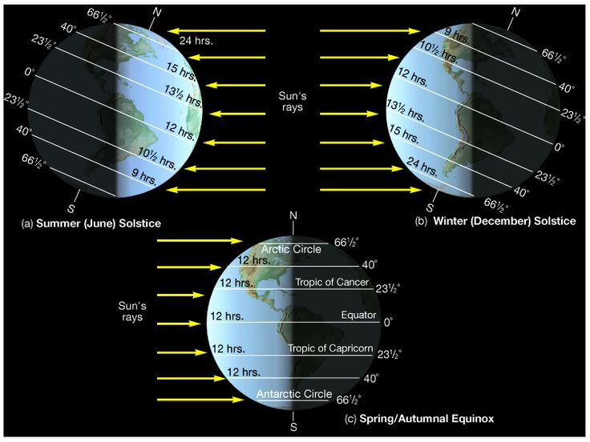
It’s caused by the Angle of Insolation (Incoming Solar Radiation). This is the angle that the Sun’s rays are striking the Earth’s surface. The Angle of Insolation is affected by: a. Latitude b. Rotation of the Earth c. Revolution of the Earth (Seasons) d. The Earth’s tilt of its axis

Slide 16
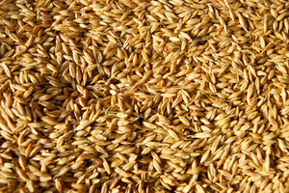
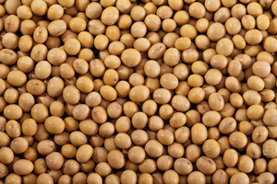
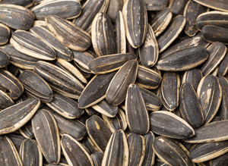
Assessment: Identify which crops can grow in the Northeastern United States Oats Soybeans Sunflower Seeds

Slide 17
HW: On looseleaf, write the following questions and answers.
Identify some crops that grow in the Northeastern Portion of the United States.
Give evidence that these crops grow in the Northeastern Portion of the United States.
Identify the causes why these crops grow in the Northeastern Portion of the United States.

