Slide 1
When is cell phone use in FDA1 building unauthorized?
Working in your groups of four or less, you will be identifying various uses of the cell phone by students that is against the rules that disrupts normal academic activities. You will be using the tool provided in Public Policy Analysis, PPA @ http://flippedtips.com/plegal/tips/select.html, as well as: Define the Problem: Worksheet#1

Slide 2
What is the proof that this problem exists in FDA1 building?
Working in your groups you will interview students, teachers, parents and other staff in the building and document your findings as evidence that this problem of unauthorized use of cell phone exists in FDA1 building. You may take some pictures and videos as further proof. Use: Gather the Evidence: Worksheet #2

Slide 3
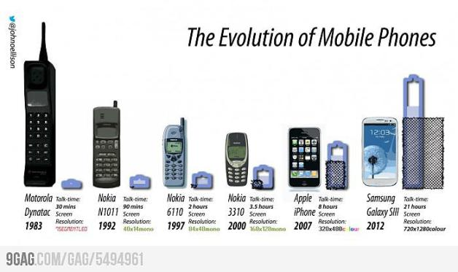
What are the causes of this problem?
You will brainstorm in your groups and with the help of your interview data and other sources like articles, journals, magazines, websites identify the causes of this problem in the building. Trace the historical development of this problem especially as related to the development of the cell phone and its availability and affordability. Use: Identify the Causes: Worksheet #3

Slide 4
What policies exist about cell phone use in FDA1 building and in NYC DOE schools?
You will explore and evaluate the existing policies about the use of cell phone in the building as well as the NYC DOE schools. Evaluate the effectiveness of the existing policies and compare the existing policies with the ones that are used in other school districts in the State and the nation. Use: Evaluate an Existing Policy: Worksheet #4

Slide 5
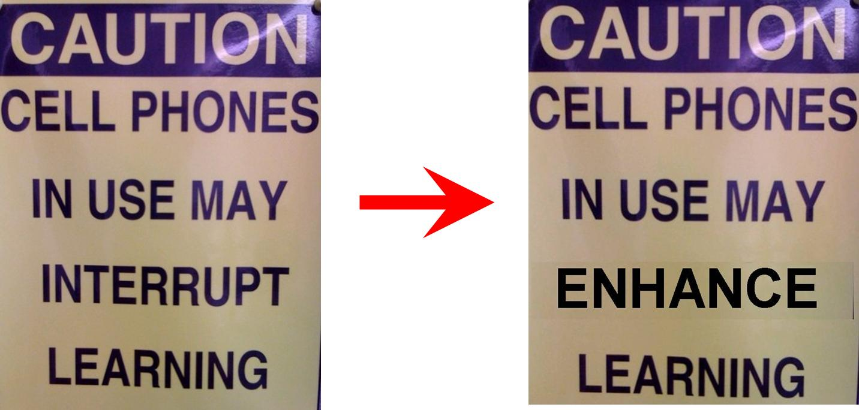
Could cell phone use in the building be beneficial to learning?
You will as well explore the pros and cones of cell phone use in the building with a view to making it beneficial to learning.
Use: Develop Solutions: Worksheet #5

Slide 6
What are the best ways to solve the problem of unauthorized cell phone use in FDA1 building?
Having examined existing policies and evaluated several solutions, suggest to the principal and the community of FDA1, what you believe is the best solution to put a stop to the problem of unauthorized use of cell phones in the building.
Use: Select the Best Solution: Worksheet#6

Slide 7
How do you present and convince the principal and the FDA1 community about your solution?
Choose a suitable presentation method; posters, video podcast, a journal, a magazine, school newspaper, a power point and so on to deliver your solution to the school community.

Slide 8
What are your resources and or references?
Document your resources and references, for example;
https://www.familyeducation.com › Kids › Kids and Cell Phones
https://www.youtube.com/watch?v=THqnUyuvSUo
Cell phone use in classrooms scholarly articles
Cell phone use in schools, the pros and cons
Cell phone use in schools, pros and cons1
See FDA1 students handbook
See Chancellors Regulation

