Slide 1

Defining the Problem
Step 1 of the Public Policy Analyst

Slide 2
Steps of the PPA Process
Define the Problem
Gather the Evidence
Identify the Causes
Examine an Existing Policy
Develop New Solutions
Select the Best Solution
Feasibility vs. Effectiveness

Slide 3
“A problem well defined is a problem half-solved.” John Dewey
“If I had an hour to solve a problem I'd spend 55 minutes thinking about the problem and 5 minutes thinking about solutions.” Albert Einstein

Slide 4
Definition
A social problem is a condition that at least some people in a community view as being undesirable.
For example:
The problem we will be analyzing is the high crime rate in our city.

Slide 5
What is NOT a social problem
Anything that begins with or asks a question
(i.e. “Should we pass a law . . . ?”)
A debate of a moral issue
(i.e. Is the Death Penalty constitutional?)
A problem could be improperly stated based on the evidence (step 2 of the PPA)
(The teenage pregnancy rate is rising in the U.S.)

Slide 6
Location of the Problem
Social problems can be found at many different levels. Therefore it is important that you are clear at which level you will be examining.
Specific community locations
your class, school or school district;
your village, town, city;
your county or state;
the United States.

Slide 7
Sample list of social problems
Below are lists of some general types of school and community problems.
SCHOOL LEVEL Low student morale Smoking in lavatories Poor academic performance High dropout rate Vandalism High absenteeism/skipping classes | COMMUNITY LEVEL Increased traffic fatalities Environmental problems Air or water pollution Solid waste disposal/landfills Poor sanitation High crime rates Violent crime Drugs Hate crimes

Slide 8
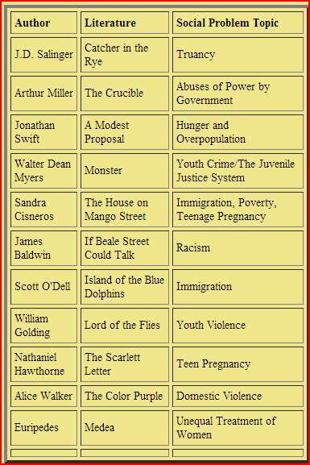
A sample list of social problems that can be used in a language arts or literature class

Slide 9
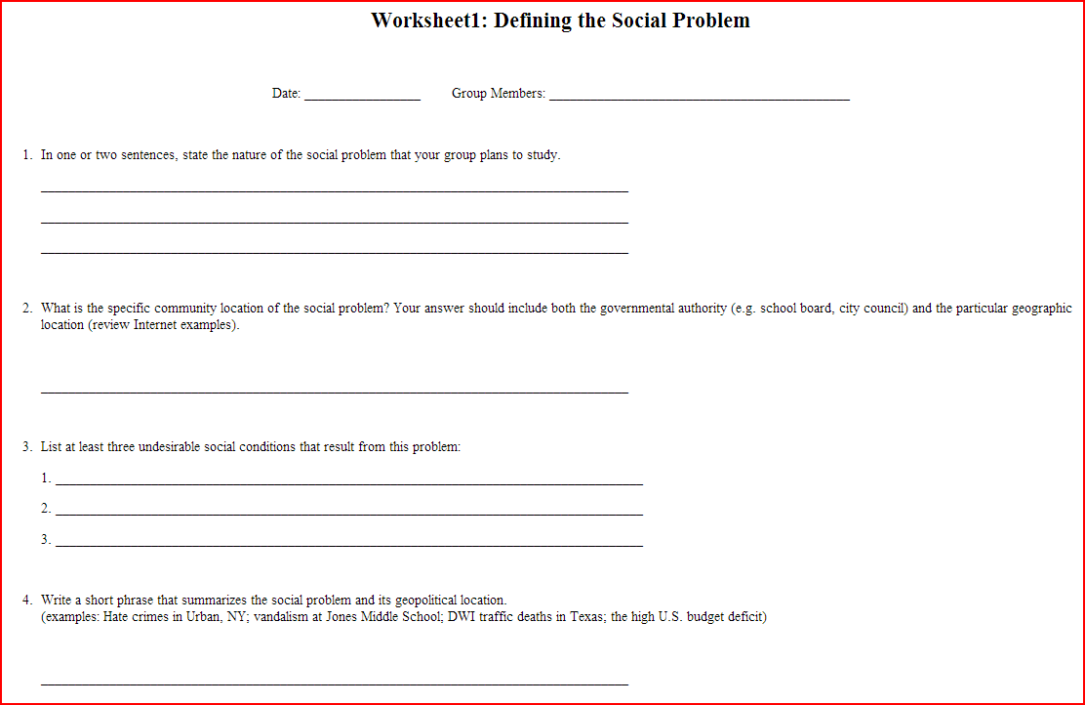
Worksheet 1
http://www2.maxwell.syr.edu/plegal/TIPS/worksheet1.html

Slide 10
Other PPA formats
The previous slides apply to a current problem in the United States.
If you wanted to explore a current global problem, then you should use the IPPA
(i.e. Thousands of acres of the rainforest are destroyed each year.)
If you want to explore an historical problem, then you would use the AHPPA or the GHPPA
(i.e. Sectional differences escalated in the 1850s in the U.S.)

Slide 11
Summary
Clear declarative statement of a measureable problem
It is a problem, not a policy
Location is specified (school, city, country)
Do not include evidence, causes or solutions at this step

Slide 12
For The First LTG Workshop
Come up with two social problems which you want your students to examine.
These problems can come from your school, community, state, country or be an international problem
The problems can also come from your curriculum (i.e. a topic your students will be exploring in the text book or an assigned reading)

