Slide 1
Lesson Plan Models for Differentiation
Responding to students’ educational needs, learning styles, personality profiles,
and interests
Heather J. Pinedo-Burns, Ed.D.
Teachers College, Columbia University

Slide 2
THERE ARE MANY DEFINITIONS OF GIFTEDNESS
Instrumental
Percentage
Process
Talent
After-the-fact

Slide 3
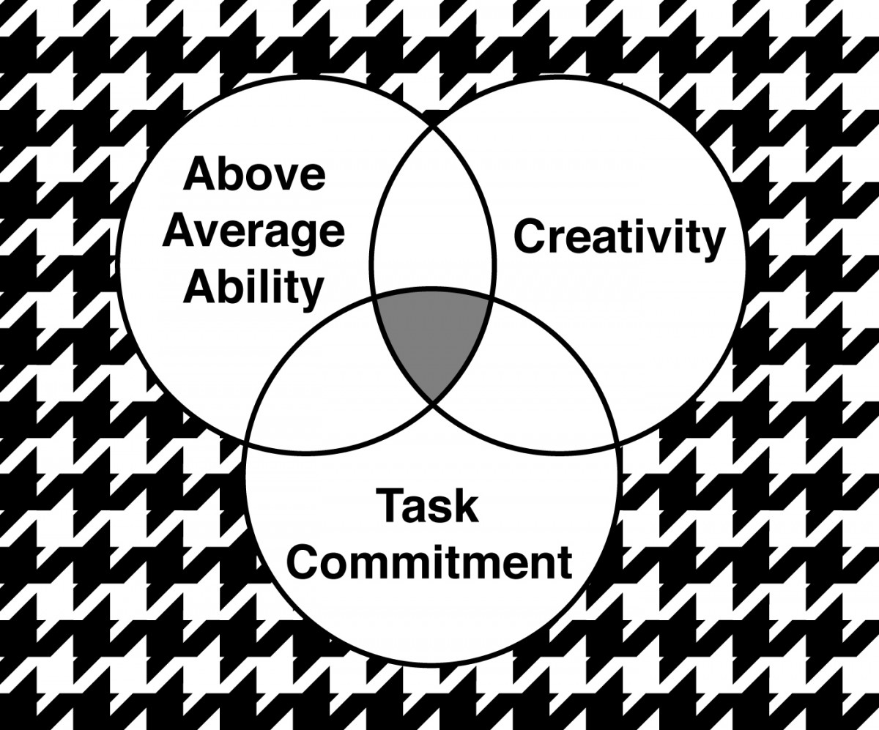
Renzulli’s Three Ring Conception of Giftedness

Slide 4
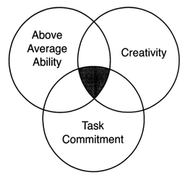
Giftedness is about the interaction of the three facets

Slide 5
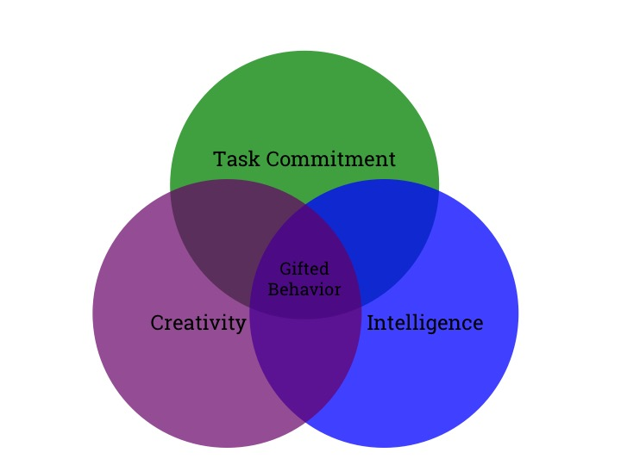
The Talent Pool is formed from students whose profile highlights the interaction of Intelligence, Creativity, & Task Commitment.

Slide 6
All children have passions. All children have potentials. All children have areas in need of support.

Slide 7

There is an
Ebb & a Flow to Differentiated Instruction

Slide 8

Differentiation is a
Cycle Of:
Planning
Enactment
Assessment
Reflection

Slide 9
We can differentiate our:
Content
What do you want your students to learn?
Process
How do you want your students to learn?
Product
How will your students demonstrate their knowledge?

Slide 10
Differentiating Content, Process & Product
Begins with the
students.

Slide 11
Often Differentiation is in response to
Student’s academic needs:
  reading level
  content skill level
  pacing

Slide 12
We can differentiate in response to student:
Readiness Skill level
Learning Profile Interests
Personality & more

Slide 13
Differentiation Always Begins with the children
What are your students’ needs?

Slide 14
Encouraging Learning
Working within children’s Zone of Proximal Development
(Vygotsky)
We want all children to feel a comfortable level of challenge.

Slide 15
Most Basic DI-Tiered Lessons
Tiered Lessons are levels that work to meet the various academic needs within your class. Often (but not always!) tiered lessons are based on Bloom’s Taxonomy

Slide 16
What can be tiered?
Assignments
Lesson Plans
Homework
Experiments
Assessments
Writing Prompts

Slide 17
ESSENTIAL ELEMENTS OF A TIERED LESSON PLAN
Tiers are leveled in cognitive complexity
Each tier engaged is matched to the learner’s level of readiness and level of mastery
Each task is respectful and engaging
Each task moves toward the same essential understanding

Slide 18
TIERED ASSIGNMENTS
Select a concept, skills or understanding
Consider students readiness, interest or learning profile
Create one activity that is interesting, requires high-level thinking & is clearly focused on the key concept, skill or generalization

Slide 19
THEN…
REVISE THE ACTIVITY TO PROVIDE DIFFERENT VERSIONS AT DIFFERENT LEVELS OF DIFFICULTY
CONSIDER USING BLOOMS TAXONOMY
MATCH STUDENTS

Slide 20
Consider…
How does this look for content?
How does this look for process?
How does this look for product?
(Complexity, depth, reading level)

Slide 21
Watching Video Examples
Use your PMI Chart to support your notes during the videos

Slide 22
Differentiating by
Student Interest
Know your learners

Slide 23
PRE-ASSESSEMENT
AS THE TEACHER WHAT DO YOU NEED TO KNOW SPECIFICALLY GOING INTO THIS UNIT OF STUDY?
  You as the teacher – what information, methods, etc. do you need?
  For your students – what information do you have about your students’ interests, abilities, previous knowledge, experiences, learning profiles?
HOW IS IT BEST TO LEARN THIS INFORMATION?

Slide 24
Interest Inventories
General – Get to Know You
Specific to Content
Learning Style
Personality Profile

Slide 25
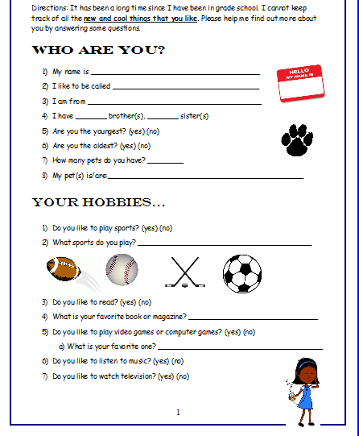

Slide 27
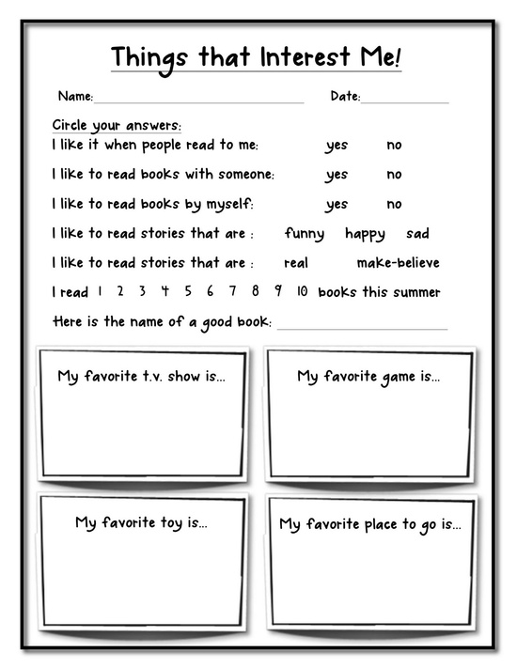

Slide 30
Name ________________________
Date _________________________
I can learn best about a subject by listening to the teacher talk
Almost never Sometimes Often
I like to take notes
Almost never Sometimes Often
I enjoy touching objects and working with my hands in class
Almost never Sometimes Often
I remember best by writing things down
Almost never Sometimes Often
Maps are easy for me to understand
Almost never Sometimes Often
The best way to remember things is to picture them in your head.
Almost never Sometimes Often
I learn to spell words by “finger spelling.”
Almost never Sometimes Often
I enjoy listening to speeches rather than reading them.
Almost never Sometimes Often
I follow oral directions better than written directions.
Almost never Sometimes Often
I enjoy giving hugs and shaking hands with people
Almost never Sometimes Often

Slide 31
Based on the students responses and content, then we must ask…
How are students learning in your classroom?
Is there choice?
How do students demonstrate their knowledge?

Slide 32
Looking at Sample Lessons Plans
Exploring Differentiated Instruction by:
Content
Process
Product

Slide 33
Beginning with the Public Policy Analyst
What is the problem?
Where is the evidence?
What are the causes?
What is the existing policy?
What policies can you create to correct the problem?
What is the best policy to correct the problem?

Slide 34
Your Questions about Lesson Planning
Ticket Out the Door

