Slide 1
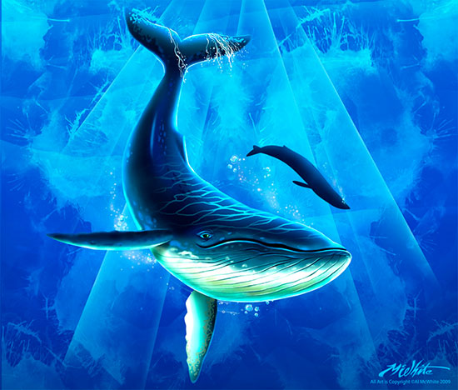
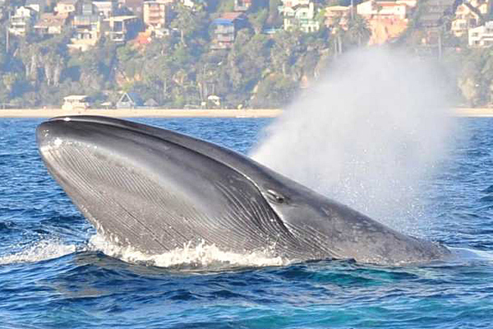
Whaling
Janet Stewart

Slide 2
Public Policy Analyst (PPA)
The 6 steps of the Public Policy Analyst (PPA)
Define the Problem
Gather Evidence
Identify Causes
Evaluate the Existing Policy
Develop Solutions
Select the Best Solution (Feasibility vs Effectiveness)

Slide 3
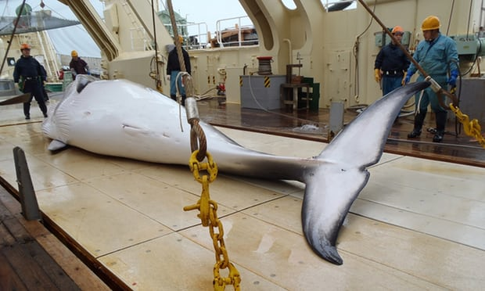
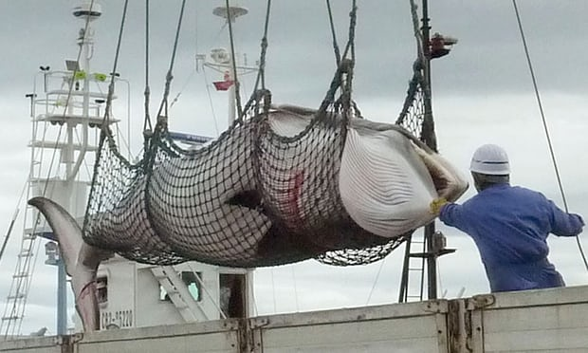
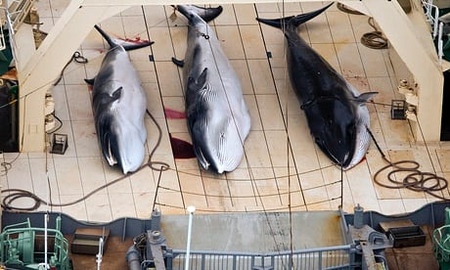
What is Whaling?
Whaling is the hunting of whales by humans. This is done for their meat, to eat in commercial (for profit) whaling operation and for oil from the whale’s fat or flesh called blubber (Jackson, n.d.).

Slide 4
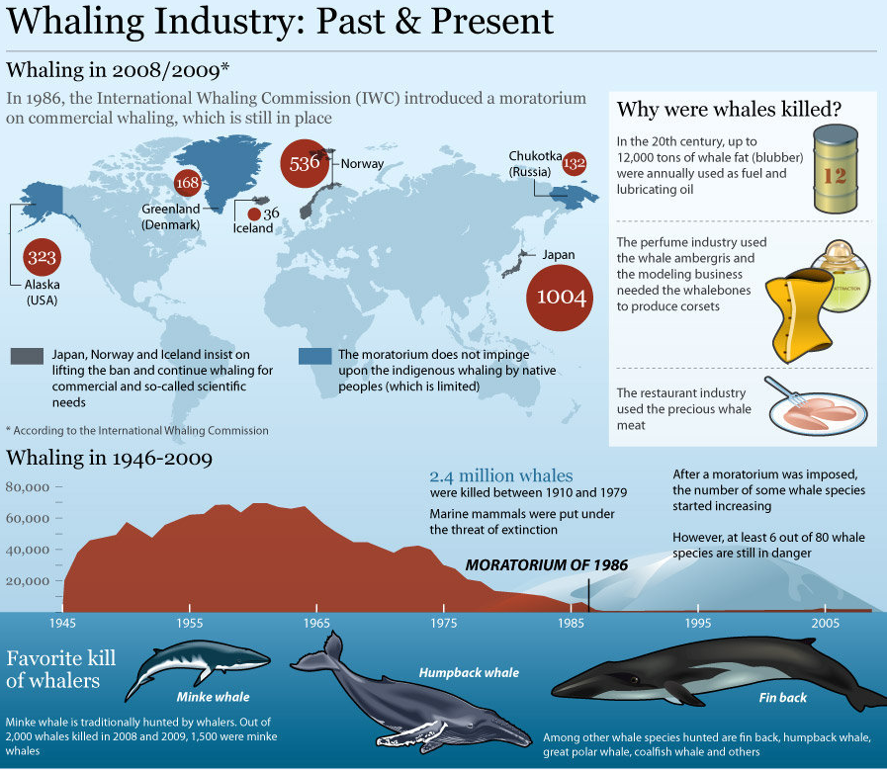
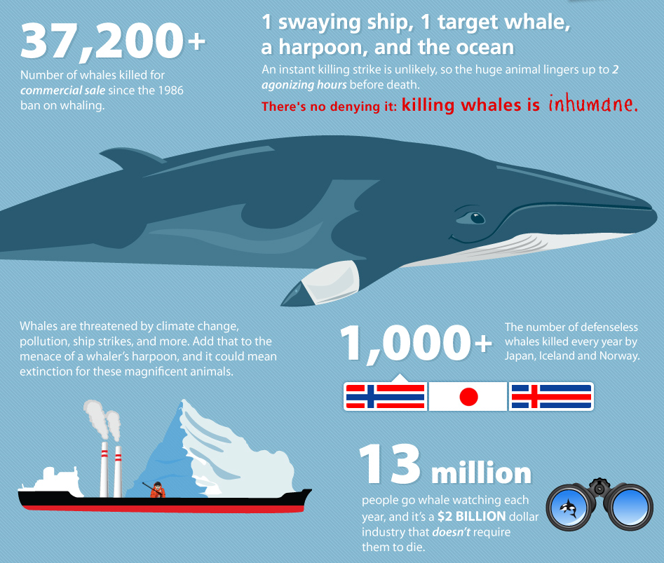
Whaling facts and figures
Humane Society International (2012)
Whaling Industry: Past & Present (2012)

Slide 5
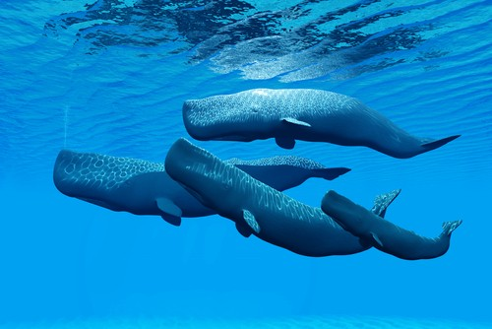
Define the Problem
Whaling has drastically reduced the number of whale spices, impacted climate change (environment) and the marine ecosystem.

Slide 6
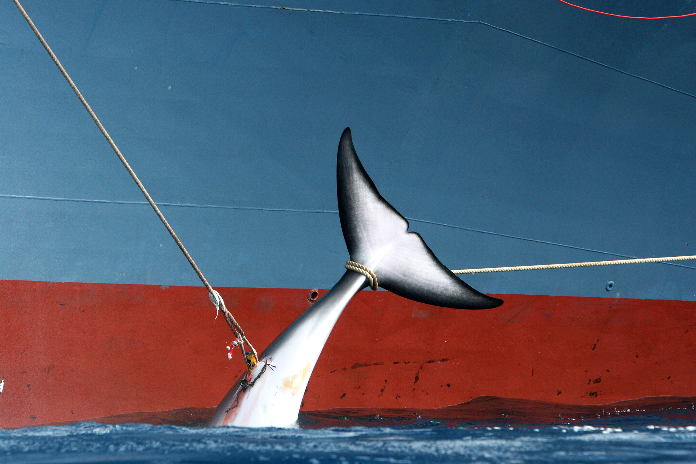
Importance of Whales
The abundance of whales are integrally tied to the health of the planet.
Whales play a vital role in the marine ecosystem where they
help provide up to 50% of our oxygen, combat climate change
and sustain fish stocks.
When they die they take huge amounts of carbon with them to the sea bed, whale carcasses fight climate change.

Slide 7
Define the Problem
What are the impacts of whaling towards climate change (Atmosphere)? | What are the impacts of whaling towards the marine ecosystem?
Worksheet1: Defining the problem
Impact towards Climate Change
Impact towards Marine Ecosystem

Slide 8
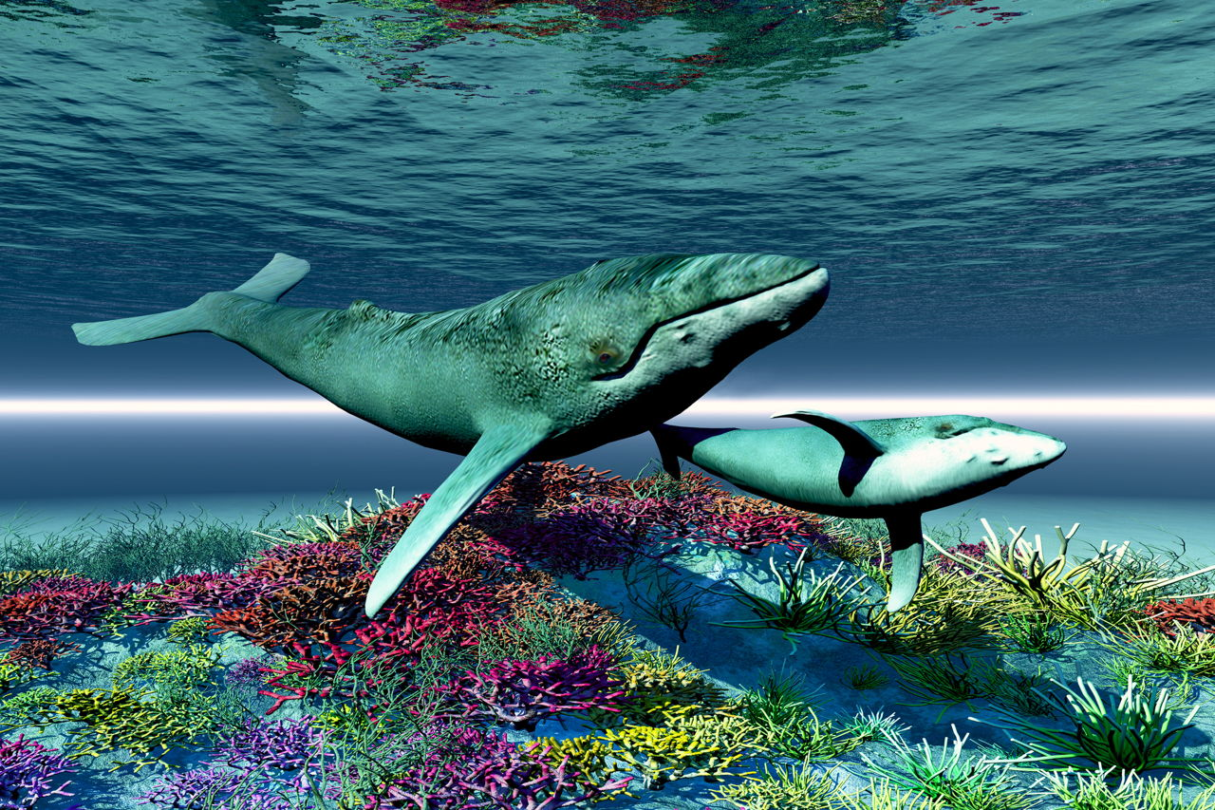
Solutions
Educating the population about the issue and raising
awareness about whaling and its negative effects.
Share with people how the ecosystem and environment
are affected by whaling.
Continuing to expose illegal sales (from Japan to overseas
customers) of whale meat.

Slide 9
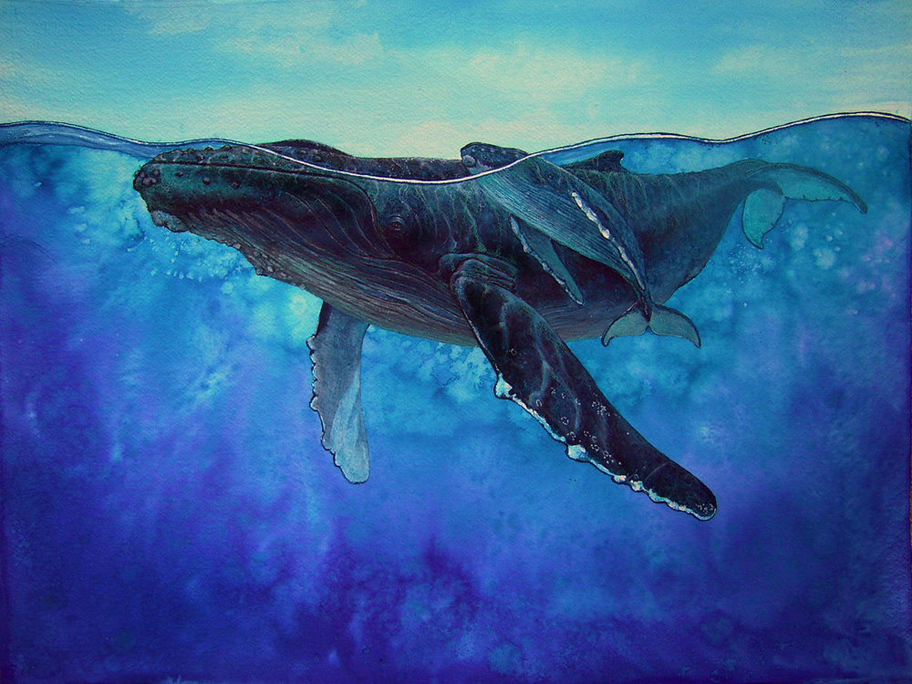
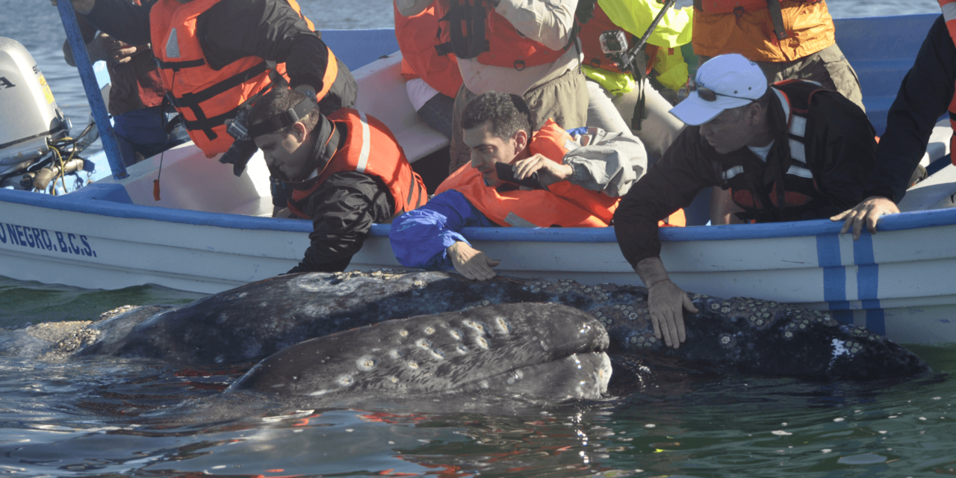
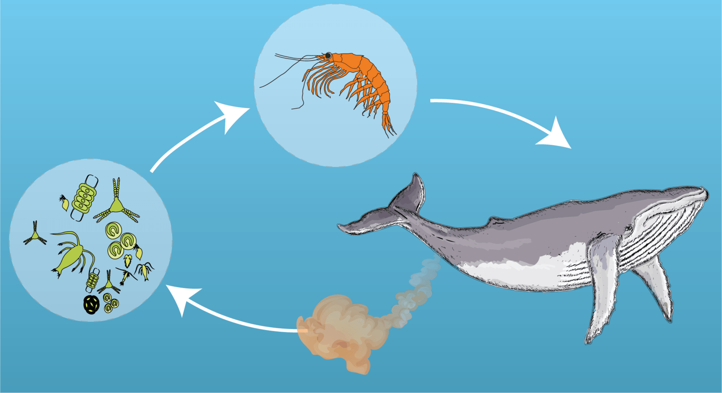
Solutions towards Whaling
How can we educate people about the negative effects of whaling to climate change?
What laws can the government put in place to stop illegal sales of whales ?
How can we share with others how the marine ecosystem is affected by whaling ?

Slide 10
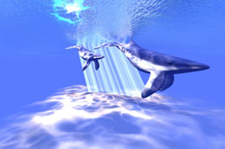
Select Best Solutions
Complete the following with your partner:
Analyze the current solutions and identify what is good
about it and what needs to be changed.
Where does your solution land in the matrix of effectiveness
and feasibility. Is it highly achievable or not very adequate?
Worksheet6: Selecting the best solution

Slide 11
References
L,. James & L,. Kevin (n.d.). Whaling. Retrieved from http://whalingecosystems.weebly.com/ecosystem.html
W,. Alexia. (2016). HSI continues the fight to protect our whales https://hsi.org.au/blog/2016/10/24/hsi-continues-the-fight-to-protect-our-whales/
Whaling Industry Present & Past (2012). Retrieved from http://www.bestinfographics.info/whaling-industry-past-present/

