Slide 1
Public Speaking for Kids
Different Ways to Teach Public Speaking to Children
By Dulce Williams-Carrero and Lillieth Skyers

Slide 2
Public Speaking for Kids

Slide 3
Ways you can teach public speaking to kids
So many children grow up with an intense fear of public speaking
...they don't want to get up in front of audiences or crowds because they are terrified of speaking in public.

Slide 4
The 6 Steps of the Public Policy Analyst (PPA)
1. Define the Problem
2. Gather the Evidence
3. Identify the Causes
4. Evaluate an Existing Policy
5. Develop Solutions
6. Select the Best Solution (Feasibility vs. Effectiveness)

Slide 5
These tips will help make kids more confident and will help them grow in their skills as public speakers and presenters.
Tip #1: Don’t Call It Public Speaking
Tip #2: Less Study, More Practice
Tip #3: Break Children Into Smaller Groups
Tip #4: Play Fun Impromtu Games
Tip #5: Teach Reason and Message Before Technique
Tip #6: Give Lots Of Positive Feedback (Lots)
Tip #7: Use Video

Slide 6
Tip #1: Don’t Call It Public Speaking
Don’t call it public speaking? Why not?
We create this importance around public speaking. We hold it up as such an important moment and important event that we scare the heck out of our children.
So how can we making more fun. Well, why don’t we call it drama, why don’t we call it “giving a monolog” or “playing speeches”?
Make it a game don’t make it an activity that kids are going to get marked on and be frightened of failing at.
We want to make it fun for our children and if we take the emphasis away from public speaking and move it more towards to having fun then kids are less likely to be afraid of it.
If we can minimize fear by changing the name then I believe we should do whatever is necessary.

Slide 7
Tip #2: Less Study, More Practice

Slide 8
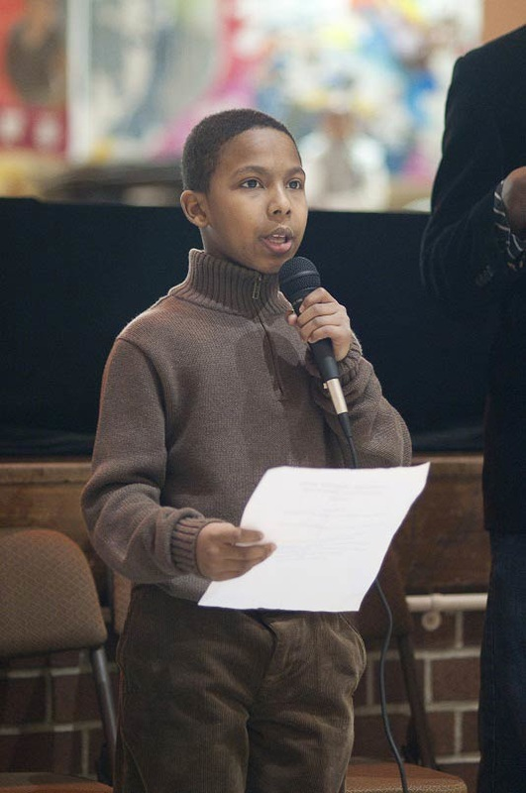

Slide 9
Tip #3: Break Children Into Smaller Groups
So we get kids to do their study and then get them to get up in front the entire class and give a speech. This is going to create fear in a lot of children.
Break your class into smaller groups or have kids present to just one person. Have them present to these small groups who can give then a positive feedback.
Then they can fail in front of few people rather than fail in front of everyone. By making the groups smaller we get more practice and its less confrontational, so we are more likely not have that fear of public speaking as we are growing up.

Slide 10
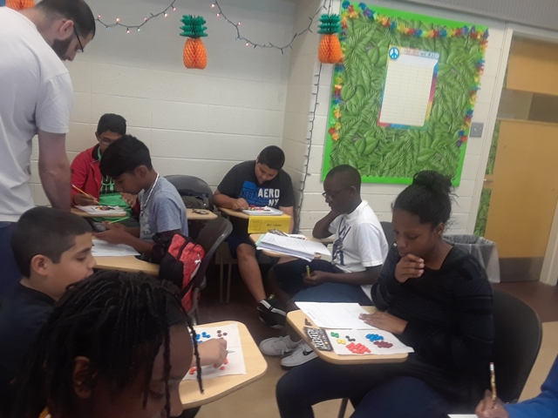

Slide 11
Tip #4: Play Fun Impromtu Games
You need to be careful with impromptu games and you need to choose the ones that are fun and people need to be in comfortable situation so that they can have a laugh if they don’t get it right.
So create impromptu games that start off really easy to built confidence. Only get into harder impromptu games as your kids become proficient public speakers.

Slide 12
Tip #5: Teach Reason and Message Before Technique
Often we rush into teaching kids public speaking technique (because it is easy to teach). But they haven’t even tried to speak in front of a crowd yet.
We start slow and we build up the technique as we go.
So with public speaking let’s use the same strategy to teach our students.

Slide 13
Tip #6: Give Lots Of Positive Feedback (Lots)
I find the best way to teach my kids is just to tell them how awesome they are doing and encourage them to keep going. Then they learn naturally!
If you absolutely HAVE to give constructive criticism then try this.

Slide 14
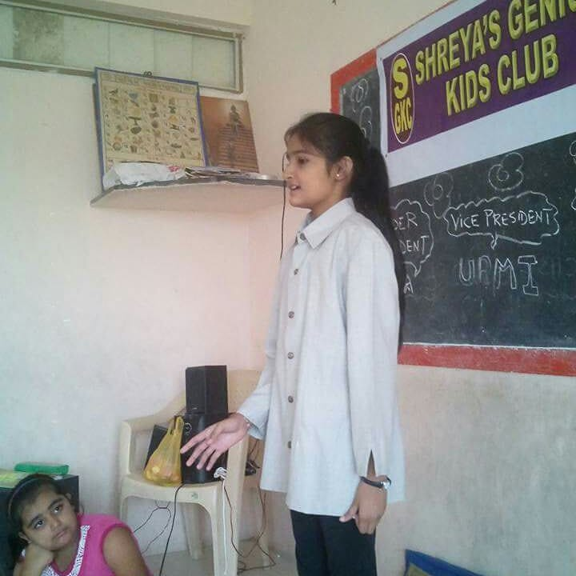

Slide 15
Tip #7: Use Video
So video is about to overtake text.
It will help them when they are going for a job (more and more interviews are now done over skype). It will help them conduct and be involved in conference calls.
They may even want to upload stuff on YouTube or create training videos and we need to help them be confident doing that.
A video camera is a great way to teach people how to get up in front of a crowd. It is a stepping stone to the stage.

