Slide 1
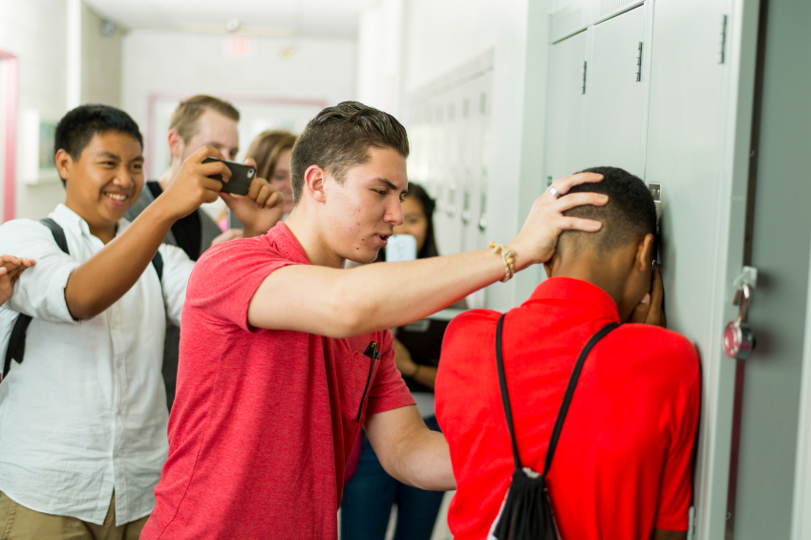
Bullying
An issue we must consider
C.S. 154
Ms. Fahy
BfAHY@SCHOOLS.NYC.GOV

Slide 2
The Issue of Bullying
The issue of bullying has received a great deal of publicity in recent years.
What exactly is bullying?
What is its prevalence?
How can it best be prevented?
Your group will:
Study this important issue and its prevalence in our own school.
Consider solutions and select the most feasible.
Prepare a proposal and presentation to share with our class.

Slide 3
Public Policy Analyst: The PPA
We will be utilizing the steps of the Public Policy Analyst (PPA) to consider the issue of bullying in our school.
Link to the Steps of the PPA

Slide 4
What is Bullying? Researching the Issue
Click on the following link: Facts About Bullying
Read the text.
Utilizing the website Fodey create a short newspaper article informing your audience about this issue. Include a definition of bullying and its prevalence.

Slide 5
Identifying the Extent of the Problem at Our School
Utilizing the worksheet located here: Identify the Problem, describe the extent of the problem at our school.
Be sure to consider the facts from the article you read and summarized using Fodey.

Slide 6
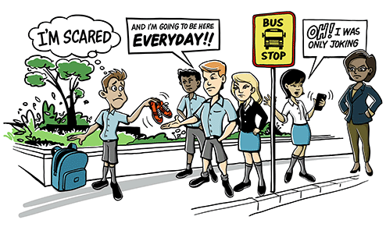
Gathering Evidence: Interviewing Your Classmates
Interview at least five classmates about their experiences involving bullying.
We call these interviews “case studies”. The students you select may discuss bullying others and/or being bullied themselves.
Utilizing the worksheet located here: Evidence, provide proof that we have a problem by citing specific information from the case studies.

Slide 7
Developing Solutions
Read the following article: What Kids Can Do
With your team, create a list of solutions. The article provides many suggestions.
Utilizing the worksheet located here: Develop Solutions, identify at least three solutions that have the potential of alleviating this problem in our school.

Slide 8
Selecting the Best Solution
Take some time to consider the three solutions you and your team identified.
Utilizing the worksheet located here: Feasibility vs. Effectiveness, identify the best solution to assist our school with the problem of bullying.

Slide 9
Completing the Final Project: Preparing a Proposal and Presentation
With your team, write a one page proposal identifying a policy our school can implement to address the problem of bullying.
Be prepared to share your proposal with our class and ultimately, the principal.

